Slide 1
RA21: Improving Access to Scholarly Resources, From Anywhere, on Any Device
speakers
Julia Wallace, Project director, RA21
RICH WENGER, E-Resource Systems Manager, MIT Library; RA21 Steering committee
Serena Rosenhan, VP User Experience Design, Proquest; Lead RA21 UX WORKING GROUP
Reggie Zamora, CSO, John Wiley and Sons; Lead RA21 Privacy and security working group
Chris Shillum, VP Identity and Platform Strategy, Elsevier; RA21 CO-CHAIR
April 26th, 2018, Philadelphia, PA, USA

Slide 2
What is RA21?
RA21: Resource Access for the 21st Century
Joint initiative of the International Association of STM Publishers (STM) and the National Information Standards Organization (NISO)
Aimed at optimizing access protocols across key stakeholder groups
Corporate and university subscribers, libraries, software vendors, publishers, identity federation operators, etc.
Purpose: To a facilitate seamless user experience beyond IP address recognition, supporting network security and user privacy

Slide 3
RA21 Goals
Recommend new solutions for access strategies beyond IP recognition in joint collaboration with software vendors, libraries, federation operators, publishers and service providers
Test and improve solutions by organizing pilots in a variety of environments
Establish best practices and publish via the NISO Recommended Practice process
New: Prepare for post-project phase by identifying potential parties to operate any necessary centralized infrastructure

Slide 4
RA21 Workstreams
User Experience
Two cross-cutting workstreams exploring topics common to both approaches
P3W
Privacy and Security
Corporate Pilot
WAYF Cloud
Pilot exploring needs of corporate segment
Two technical pilots exploring different implementation approaches

Slide 5
Security & Privacy Workstream Update Reggie Zamora, CSO, John Wiley and Sons Lead RA21 Privacy and Security Working Group

Slide 6
RA21 Security / Privacy Team
Active team of volunteers from multiple organizations:
Wiley (CSO, facilitating)
ACS (CSO)
ProQuest (CISO)
IEEE (Digital License and Compliance)
University of Illinois at Urbana-Champaign (Coordinator for Information Literacy Services and Instruction)
And others, Taylor & Francis, ORCID, …

Slide 7
RA21 Security / Privacy Analysis
Objective:
Assess security and privacy risks associated with the two pilots
Provide recommendations tailored to mitigate risks identified for each
Methodologies used:
STRIDE Threat Model for security
Spoofing Identity
Tampering with Data
Repudiation
Information Disclosure
Denial of Service
Elevation of Privilege
DPIA for privacy
Data Protection Impact Analysis
Performed in compliance with GDPR

Slide 8
RA21 Security / Privacy Executive Summary
There are no significant risks which prevent the WAYF Cloud and P3W pilots from moving forward
Residual risks from both security and privacy perspectives are LOW
The nature of the data involved is low value, i.e., not directly or easily attributable to any natural person
Appropriate safeguards are in place to mitigate confidentiality concerns

Slide 9
WAYF Cloud Security Assessment
The WAYF Cloud has a larger attack surface on the server side, due the server API and centralized storage. However, the effort to perform an attack is high provided that standard security practices are followed.
The WAYF Cloud is a passive element in the process of user authentication and authorization and its availability doesn’t affect the ability of users to authenticate at a Service Provider. Given the nature of the data involved, the damage of a successful attack is small given that sufficient data protection measures are taken.
In a worst-case scenario, damage is limited to the degradation of user experience and to the disclosure of Identity Providers and their association with anonymous entities.
All threats are low priority (priority 4) and the risks can be mitigated by applying standard security and data protection practices.

Slide 10
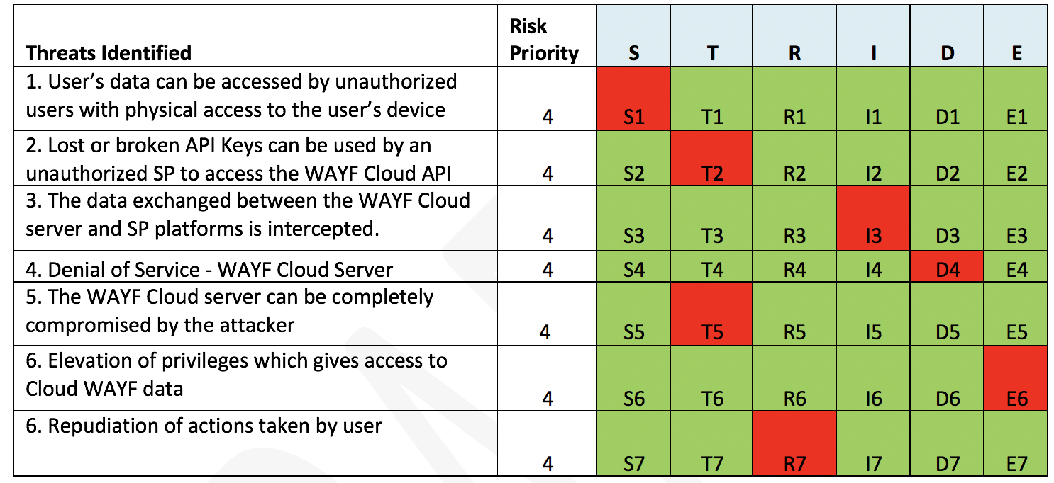
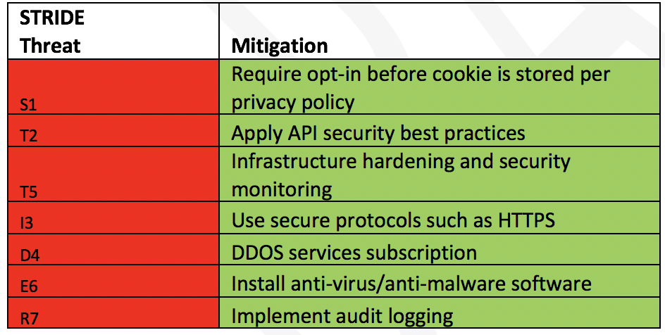
WAYF Cloud Security Assessment

Slide 11
P3W Security Assessment
P3W has lower attack surface on the server side as it doesn’t utilize server APIs or central storage
Its role in the process of user authentication and authorization, is that of an external SAML discovery service (except for integration Level 4)
The availability of P3W can affect the ability of users to sign-in at the SP using their institutional IdP and ultimately get access to institutional resources
The compromise of the P3W server can be used to perform password phishing attacks by directing users to fake IdP pages
The P3W Implementation level 4 utilizes the browser local storage as common storage across different SP domains. Client-side cross domain storage is generally considered insecure and its restricted by the web browser
The threats for P3W are priority 3 and 4. The risks can be mitigated by using a highly available and secure infrastructure. The need for higher protection measures justified by the increased risk

Slide 12
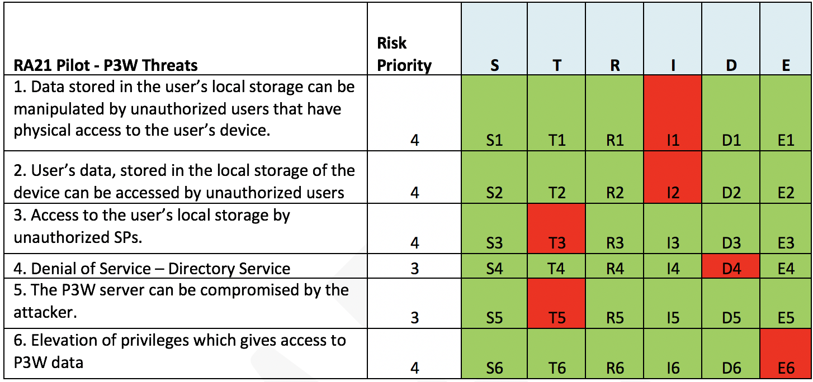
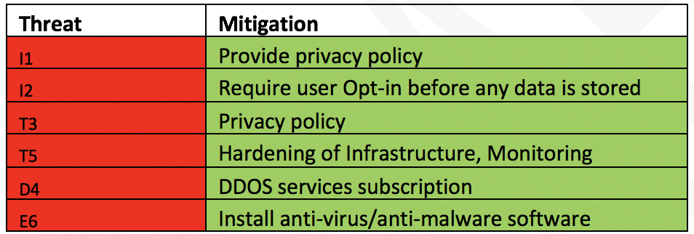
P3W Security Assessment

Slide 13
Privacy Assessment Executive Summary
Data is randomized and not directly attributable to a natural person
No ‘high risk’ personal data such as biometric, health, or criminal records is processed
Data is encrypted and salted

Slide 14
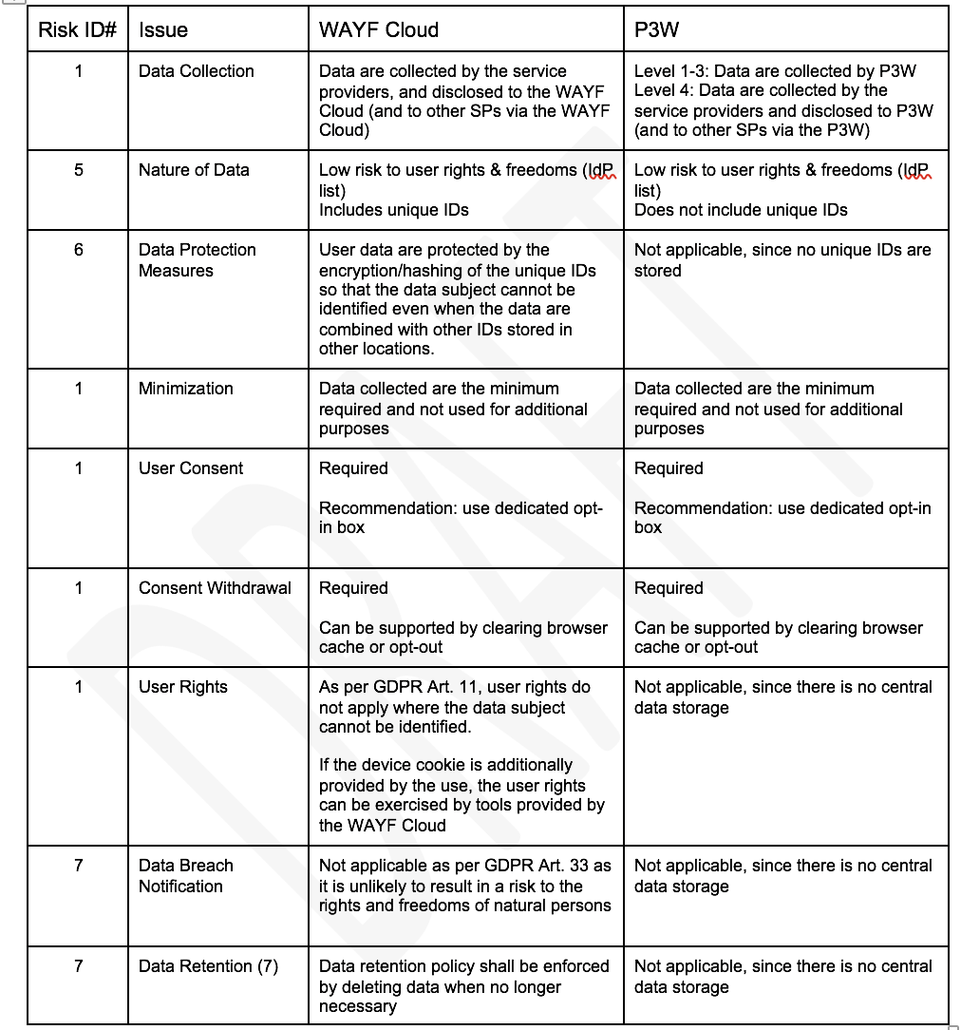
Privacy Assessment

Slide 15
Concluding Remarks Chris Shillum, Elsevier Co-Chair RA21

Slide 16
Specific Challenges for Scholarly Information Resource Access
Unlike in B2C, we have a proliferation of Identity Providers. It’s not just Google and Facebook – we have literally thousands of universities and corporations managing the identities of our users
Need a solution that works at point of access (e.g. Google search results page) without configuration ahead of time
Requirement for strong privacy protection and support for anonymous access
Need for consistent UX across multiple resource providers

Slide 17
Takeaways: RA21 vs. IP-based RA Solutions
No prior setup required (e.g. to configure a proxy/vpn server, pair a device, etc.). No disruption to the research discovery workflow.
Ability for publishers to offer differentiated user experience or differentiated services based upon user attributes (not identity).
Ability to block a single user account instead of an IP address, and offer more targeted information to campus security to investigate potentially compromised credentials.
Ability to offer more granular usage reporting back to subscribers.

Slide 18
RA21 Roadmap
Q1 2018
Early outputs
Position papers
Q1/Q2 2018
Mid-term outputs
Task Forces: UX; Security / privacy
Pilots: Options for discovery; technology platforms
Q2/Q3 2018 Draft recommendations and open consultation
(via NISO process)
Q4 2018 and onwards Final recommendations published
Recommendation for infrastructure operator
Beyond 2018 STM hands over the lead of the project to NISO for adoption and implementation Creation of and involvement in Operational User Communities
Throughout 2018 and onwards
Ongoing outreach engagement across key stakeholder communities

Slide 19
Outreach Activities
CNI - December 2016, April 2017
STM - December 2016, July 2017, December 2017
SSP - May 2017
JISC - July 2017
AGLIN Forum - August 2017
SURF - September 2017 Utrecht
Internet2 - October 2017 San Francisco
Charleston Conference - November 10, 2017
UKSG - November 16, 2017
CCC - hosted webinar November 16, 2017
ALA Midwinter - January 20-24, 2018 Denver
PSP - February 7-9, 2018 DC
ER&L – March 6-8, 2018 Austin
MLA Insights – March 6, 2018 Chicago
ACS – March 18-22, 2018 New Orleans
RA21 in the News
Myth Busting: Five Commonly Held Misconceptions About RA21 (and One Rumor Confirmed)
https://scholarlykitchen.sspnet.org/2018/02/07/myth-busting-five-commonly-held-misconceptions-ra21/
UKSG Insight – Opinion Pieces: “Easy access to the version of record (VoR) could help combat piracy: views from a publishing technologist” Author: Tasha Mellins-Cohen. 10 July 2017.
Society for Scholarly Publishing – Scholarly Kitchen: “Failure to Deliver: Reaching Users in an Increasingly Mobile World” Author: Todd Carpenter. 15 June 2017.
Library Learning Space: “RA21 and libraries” 16 May 2017.
Index Data: “RA21 Project aims to ease remote access to licensed content” Author: Peter Murray. 19 December 2016.
STM – April 24-26, 2018 Philadelphia
MLA - May 18-23, 2018, Atlanta
SLA – June 9-13, 2018 Baltimore
Notes:
The General Data Protection Regulation and the e-privacy regulation proposal arising from the EU provide a strong set of considerations that act as powerful input to the expectations of the project.
All of the currently proposed pilots make use of SAML federated authentication technology which has in-built mechanisms for preserving privacy.
This puts the institution, and the user, fully in control of what personally identifiable information is disclosed to a resource provider via what are called “attribute release policies”.
Typically, academic SAML Identity Providers provide unique, persistent, but opaque identifiers, which provides a way for publishers to personalize services for users without knowing the actual identity of the individual.
Optionally, publishers may then ask for additional personal information from users via their normal registration processes, disclosing their privacy policies, in order to provide services which require the publisher to know the identity of the user, such as email alerts.

Slide 20
Questions?
Visit: https://www.RA21.org
Contact:
Julia Wallace
Program Director
Julia@RA21.org
Heather Flanagan
Pilot Coordinator
Heather@RA21.org
Meltem Dincer mdincer@wiley.com
Chris Shillum c.shillum@elsevier.com
Ralph Youngen ryoungen@acs.org

