Slide 1
Resource Access for the 21th Century a NISO-STM Initiative
STM Innovations
6 December 2017
Julia Wallace
RA21 Project Director

Slide 2
What is RA21?
RA21: Resource Access for the 21st Century
Joint initiative of the International Association of STM Publishers (STM) and the National Information Standards Organization (NISO)
Aimed at optimizing access protocols across key stakeholder groups
Corporate and university subscribers, libraries, software vendors, publishers, identity federation operators, etc.
Purpose: To a facilitate seamless user experience beyond IP address recognition, supporting network security and user privacy

Slide 3
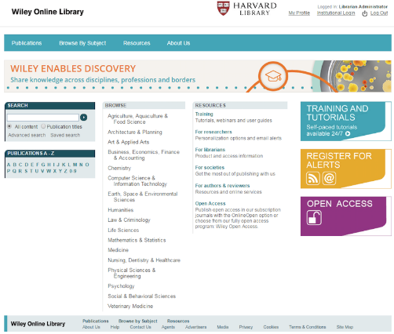
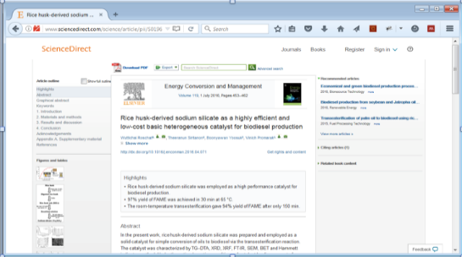
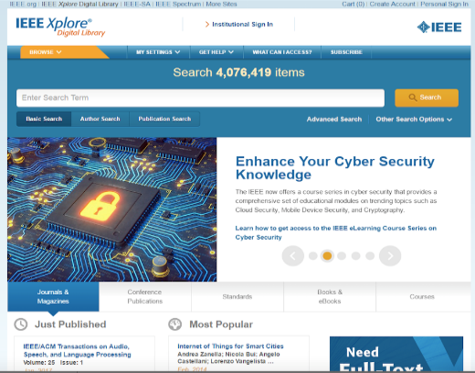
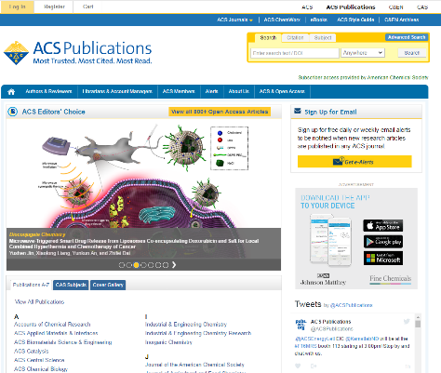
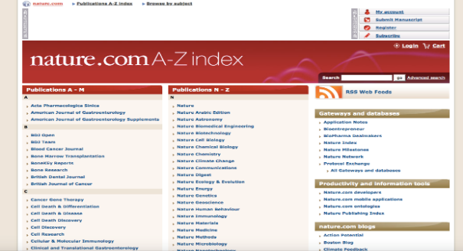
Late 20th Century: from print to digital
Imitate print experience for libraries and users
Optimized for ease of use and removal of barriers to encourage migration from print to digital
IP address recognition became the de facto industry standard for site access

Slide 4
Early 21st Century: digital and remote
Technology evolved
Growing diversified scholarly eco-system
Multiple entry points, e.g. mobile and remote access
Changing user expectations and behavior
Significant growth of usage outside of corporate/campus networks

Slide 5
RA21 Problem Statement
IP-based access management increasingly problematic
No seamless access from any device, location, or search engine
Inconsistent and confusing patchwork of access solutions while off of the corporate/campus network (e.g. VPN servers, Proxy servers, Shibboleth)
Increasing volume of illegal downloads and piracy
Lack of user data to develop user-focused, personalized services

Slide 6
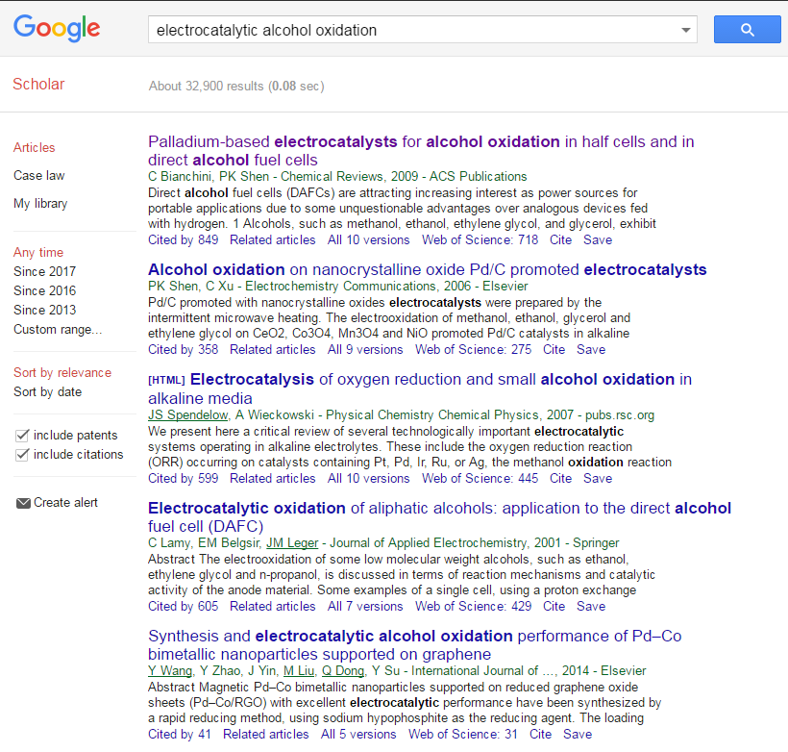
How a user experiences access to resources on campus
1

Slide 7
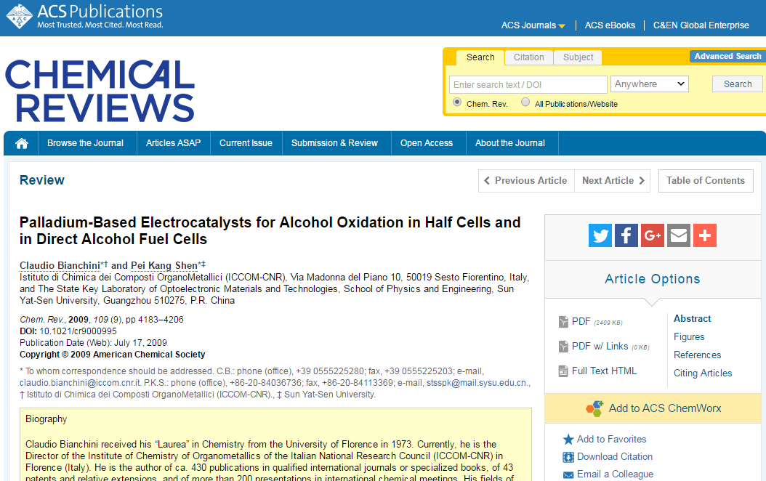
How a user experiences access to resources on campus
2

Slide 8
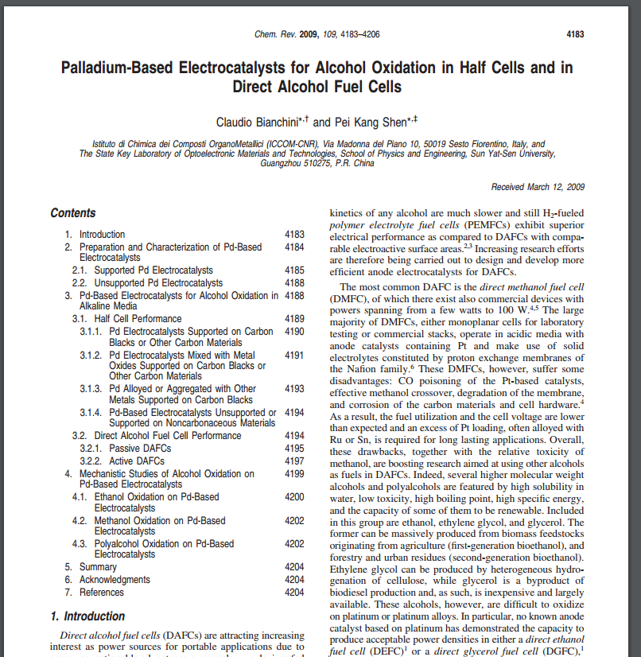
How a user experiences access to resources on campus
✓
2

Slide 9
How a user experiences access to resources off campus
1

Slide 10
How a user experiences access to resources off campus
2

Slide 11
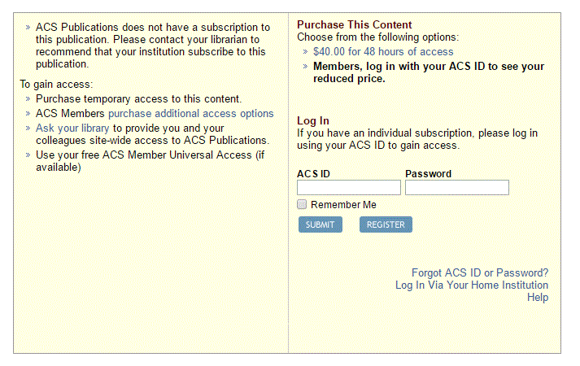
How a user experiences access to resources off campus
3

Slide 12
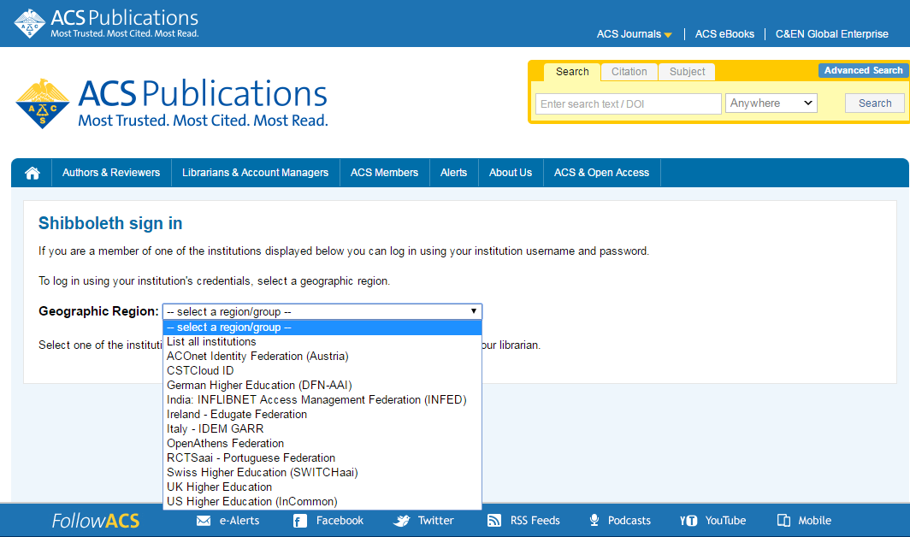
How a user experiences access to resources off campus
4

Slide 13
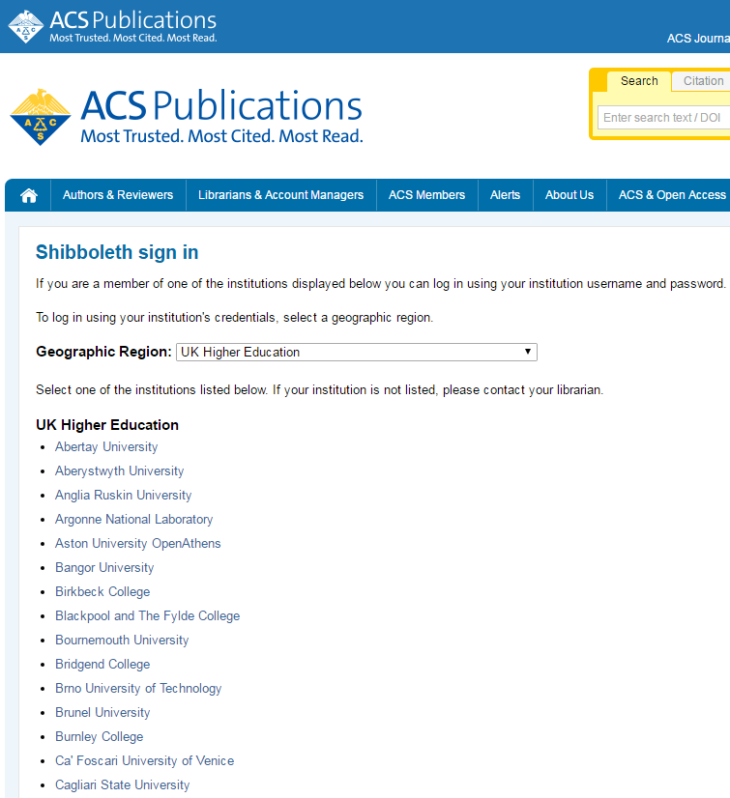
How a user experiences access to resources off campus
5

Slide 14
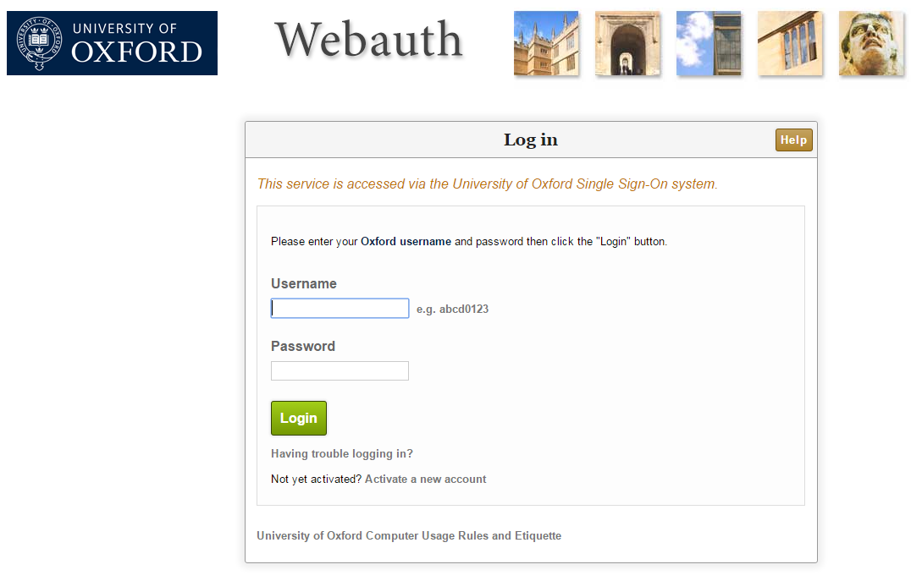
How a user experiences access to resources off campus
6

Slide 15
How a user experiences access to resources off campus
✓
6

Slide 16
RA21 Principles: It must be open
The solution cannot be proprietary
The solution should be (reasonably) easy to implement
The solution must be vendor neutral
Should not create tremendous amounts of new work, implementation cost, or ongoing maintenance.
Should allow for gradual implementation
RA21 will develop Best Practice recommendations
RA21 will not develop a specific technical solution or one industry-wide authentication platform

Slide 17
Three Pilots
Corporate Pilot
Academic Pilots:
Privacy Preserving Persistent WAYF (P3W)
A shared discovery service based on storing information in the browser
WAYF Cloud
A shared discovery service based on centralized information sharing
Pilots working together on:
User experience and a reference UI
Privacy and security issues

Slide 18
RA21 Timeline
Q3 16 – approval STM Board, taskforce, use cases, guiding principles
Q4 16 – first public presentations on RA21, first workshop
Q1 17 – staff hiring, project adoption by NISO
Q2-Q4 17 – workshops and outreach
Q1 18 – round-up pilots
Q2 18 – 1st draft best practices
Q3 18 – publication of project results
Anticipated Long-Term Outputs arising from RA21:
Operational User Communities

Slide 19
Who’s Involved
Steering committee
Chris Shillum, Elsevier (Co-chair)
Meltem Dincer, Wiley (Co-chair)
Gerry Grenier, IEEE
Laird Barrett, Springer Nature
Ralph Youngen, ACS
Dan Ayala, Proquest
Don Hamparian, OCLC
Leif Johansson, SUNet
Ann West, InCommon
Andy Sanford, Ebsco
Josh Howlett, Jisc
Rich Wenger, MIT
Peter Brantley, UC Davis
Helen Malone, GSK
Todd Carpenter, NISO
Eefke Smit, STM
Ann Gabriel, Elsevier (RA21 Outreach Committee)
Outreach & Communications committee
Michelle Brewer, Wolters Kluwer
Sam Bruinsma, Brill
Angela Cochran, ASCE
Ann Gabriel, Elsevier (Chair)
Don Hamparian, OCLC
Robert Kelshian, American University
Tim Lloyd, LibLynx
Judy Luther, Informed Strategies
Matt McKay, STM
Jonathan Morgan, ACS
Jean Shipman, Elsevier
Lauren Tulloch, CCC
Keith Webster, Carnegie Mellon University
Staff
Julia Wallace, Project Director
Heather Flanagan, Coordinator Academic Pilots
Jenny Walker, Coordinator Corporate Pilot
Combined with our Multi-stakeholder Advisory Group & Pilot Participants:
Over 65 organisations from key stakeholder communities are represented within RA21

Slide 20
Resource Access for the 21th Century Position Papers
STM Innovations Day
6 December 2017
Heather Flanagan, RA21 Academic Pilot Coordinator

Slide 21
RA21 Position Papers
What are position papers?
short, targeted documents describing agreed upon best practices that can be implemented today
Who is the target audience?
IT managers and leaders

Slide 22
Recommendations to Identity Providers and Federation Operators
need for more complete metadata records from Identity Providers (IdPs) in SAML-based federations
this will allow Service Providers (SPs) to offer end users a better user experience
review session management configuration to (potentially) support logins once per business day and offer a seamless experience for all SPs

Slide 23
Recommendations to Content Providers
normalize the language used on user-facing authentication pages
basic presentation of login options to the user
making use of the MDUI hints (esp. logos) offered by the IdP

Slide 24
(Possible) Future Papers
Additional papers may be developed
looking for early wins and consensus on specific items
These papers, along with the other outputs of the project, will wrap up in a final package that will be fed through the NISO standards process

Slide 25
Helen Malone Director, Information Hub
RA21 Corporate Pilot:
A Customer Perspective
6th December 2017

Slide 26
Objectives for the RA21 Corporate Pilot
Test Single Sign On access with pilot publishers
Improve the user experience at pilot publisher sites
Explore ways to capture granular usage statistics

Slide 27
Corporate Pilot: Pharma Companies & Publishers

Slide 28
Example of a Potential New Access Model: Inside the Corporate Network
Step 1:
sciencedirect.com
Enter your work email address:
acs.org
Helen.J.Malone@gsk.com
Or find your company name:
GSK
springernature.com
No personal information stored
wiley.com
Example: 90-day cookie for future 1-click access
SSO
(eg Ping Federate)

Slide 29
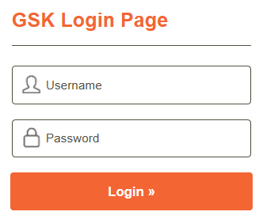
Example of a Potential New Access Model: Outside the Corporate Network
Step 1:
Enter your work email address:
sciencedirect.com
Helen.J.Malone@gsk.com
Or find your company name:
GSK
acs.org
No personal information stored
Step 2:
springernature.com
wiley.com

Slide 30
Easy Set Up between Companies and Publishers?
Corporate Federation?
One Corporate Federation

Slide 31
Usage Statistics: Knowing what and when our users download
User Login ID or Email Address
Monthly Automated
Secure File Transfer
Meaningful Usage Reports
2. Publisher Bibliographic Info
3. Publisher Date / Time Stamp
7

Slide 32
Usage Statistics: An additional attribute
User Level Statistics
7

Slide 33
Working Together in Partnership
Customers
Publishers
Technology Experts
Phased Approach to Implementation

Slide 34
User Experience
Ralph Youngen, Director, Publishing Systems Integration, American Chemical Society
RA21 Steering Committee Member
December 6, 2017

Slide 35
RA21 User Experience
“You have to start with the customer experience and work your way back to technology.” — Steve Jobs

Slide 36
RA21’s User Experience Challenge
Today:
Awesome user experience on campus
Awful user experience off campus
Tomorrow:
Consistent user experience anywhere on any device
Challenge:
On campus user experience will become slightly less seamless

Slide 37
RA21’s User Experience Goals
Improve the Where Are You From (WAYF) User Experience
Encourage consistency across all publisher websites
Reduce the number of times a user encounters the WAYF
Share users’ preferred identity providers across publishers subject to both user privacy and publisher confidentiality concerns

Slide 38
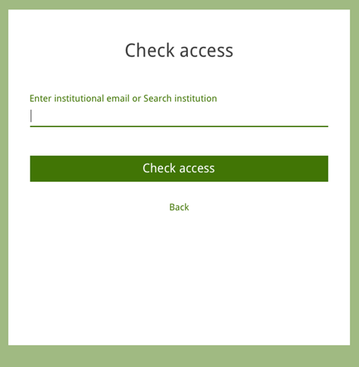
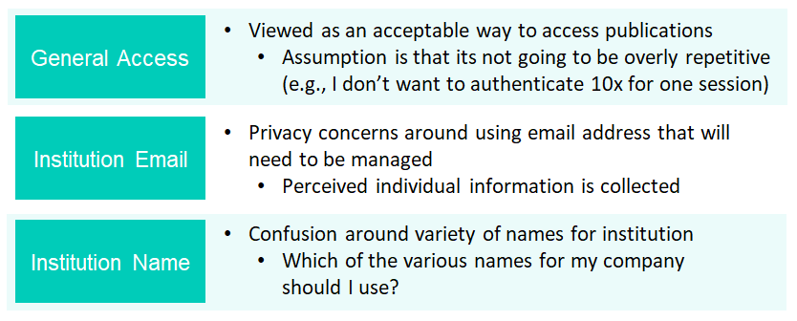
RA21 UX Development Across the RA21 Pilots
Corporate Pilot
Developed prototype WAYF UX based upon institution name or institution email address lookup
Tested prototype with ~50 corporate scientists

Slide 39
RA21 UX Development Across the RA21 Pilots
UX work that began under Corporate Pilot is continuing as a single track across both the P3W and WAYF Cloud pilots
Heavy emphasis on how to accomplish cross-publisher sharing of prior identity provider choices
RA21 UX Demo
Warning: Work in Progress!

Slide 40
Pilot Approaches to Cross-Publisher Sharing P3W vs. WAYF Cloud
 | Sharing Approach | User Experience Impact | Security/Privacy Impact
P3W | Prior identity provider choices are stored in local browser storage. | Tradeoff between UX options at publisher site and browser compatibility. May require iFrames or other approaches that stretch browser compatibility. | Less impact. Only IdP choices stored. All data stored in local browser.
WAYF Cloud | Prior identity provider choices are stored in a centralized service. | Less impact. Prior identity provider choices are retrieved via backend call to centralize service. | Potential concern. Requires trusted third party to protect data. May not be compatible with privacy regulations.
Evaluation Criteria:
UI/UX Flexibility
User Privacy
Publisher Privacy
Browser Compatibility
Implementation Complexity
Transparency
Resilience
Etc.

Slide 41
Questions?

Slide 42
The P3W Pilot Privacy Preserving Persistent WAYF
Chris Shillum
VP Identity and Platform Strategy, Elsevier
RA21 Co-chair
December 6, 2017

Slide 43
P3W Pilot Goals
To improve current SAML (Shibboleth) Identity Provider (IdP) discovery process
Incorporate additional “WAYF hints” such as email domain and IP address into federation metadata
Use both browser information and shared metadata hints to narrow down IdP options for the user without tracking the user
Improve sign-in flow by using smart search and asking for minimal information up front
Implement consistent, familiar UX across particpants
Enable cross-Service Provider persistence of WAYF choice using browser local storage
Pilot participants
SUNet (lead)
Geant (project management)
American Chemical Society
CANARIE
EBSCO
Elsevier
Johns Hopkins
LibLynx
myunidays
OpenAthens
ProQuest
University of Nottingham

Slide 44
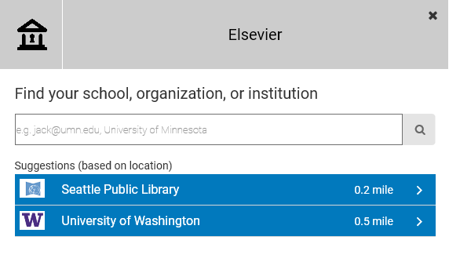
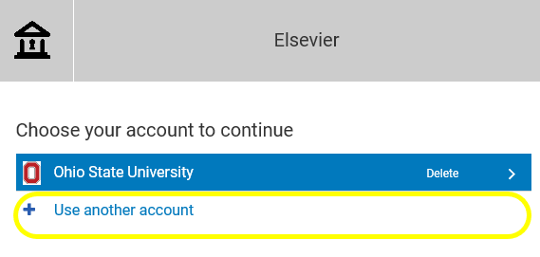
P3W Components
IdP Search
“Smart” search service making use of IdP metadata and browser hints and knowledge of which service providers work with which IdPs
IdP Choice Persistence
Remembers previously used IdPs in browser local storage
Gives user control over which service providers they share this information with
Services may be used separately in deep integration model

Slide 45
P3W Integration models
Central discovery service
Service provider redirects user to central site to handle IdP selection
Very simple integration model for SPs
Deep integration
Service provider integrates search and/or IdP choice persistence into their own UI using shared Javascript
Allows for more seamless UX
Service Provider
Discovery Service
Identity Provider
Discovery Service
Service Provider
Identity Provider

Slide 46
UI Flow – User Perspective
Step one: discovery service checks the browser’s local store and displays the last IdP (or set of IdPs) used by the user.
Step two: if the local browser store is empty, or if the user chooses not to use any of the IdPs offered, the user will be presented with a search interface or a list of IdPs

Slide 47
Preserving Privacy
 | Technique | Challenge
 | Full email address (if entered) does not leave the browser: Only domain needs to be shared with discovery service and only IdP choice needs to be shared with service provider | Need to define and test a standardized UI that makes this clear to users
 | IdP preference is stored locally in the browser, retrieved using centrally served javascript, not on a central server | Need to ensure that this model is compatible with latest browser initiatives to tighten up cross-domain communication

Slide 48
Challenges
Architecture for deep integration option
There are several different models for integration, e.g
iFrames to render part of UI
iFrames for inter-domain messaging
Need to find right balance between UI consistency and flexibility and browser security model
Local accounts
Most SPs need to support a variety of integration models
Local usernames/passwords
Non-federated IdPs
Need to ensure that these options can be smoothly accommodated in the UI flow
IdP Metadata
Need IdPs to ensure necessary information (email domains, logos, etc) is accurately and consistently included in federation metadata
Need feedback process when metadata is incorrect, incomplete or inconsistent

Slide 49
Progress and Next steps
SUNet’s pyff.io pilot platform has been extended to support:
Cross-domain shared settings based on browser local store and hidden iFrame messaging
Low-level discovery client API
jQuery widget to provide customizable discovery API
Several other pilot participants are now working to integrate with this service in a sandbox environment

Slide 50
The WAYF Cloud Pilot
Meltem Dincer
VP, Platform Capabilities, Wiley
RA21 Co-chair
December 6, 2017

Slide 51
WAYF Cloud Pilot Goals
To provide a seamless user experience as close as possible to IP Authentication
Eliminate steps users have to repeat at every publisher
Leverage existing organizational systems/protocols for user authentication
Create an infrastructure for sharing WAYF data amongst publishers
Embrace OpenSource Software development
Establish easy integration points with service provider platforms
Look to form a potential industry standard for WAYF data exchange
Data Format
Modern Interface Specification
Pilot participants
Atypon
OpenAthens
RINGGOLD
SAGE
Silver Chair
UC Davis
Wolters Kluwer
WILEY

Slide 52
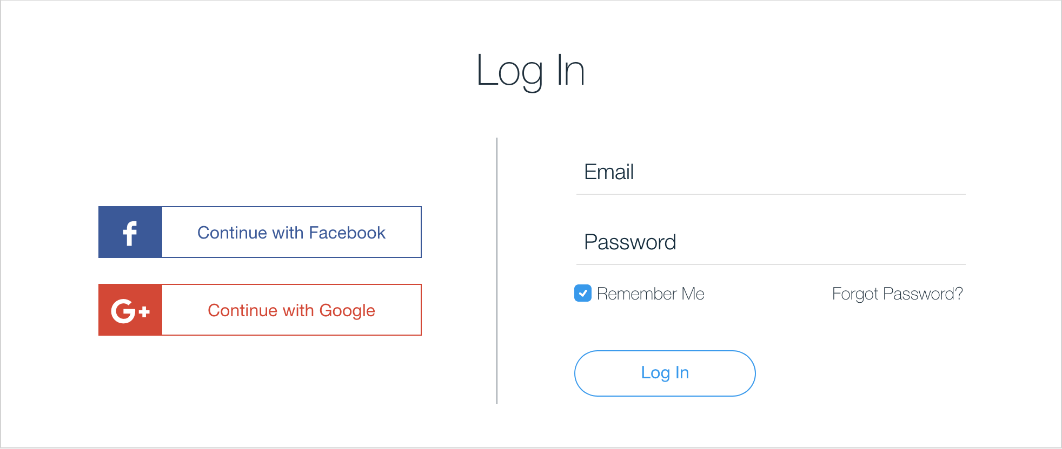
Desired User Access Experience
Private Experience
Target Institutional Experience
Notes:
This is the de-facto standard user experience for loging in to websites today
The likelihood that a random user can login with one of the options presented in this screen is very large
Using an Identity provider such as Google or Facebook is very convenient for the users because they don't have to remember yet another username and password
Its also very quick. In most cases, the user doesn’t even face a new authentication challenge because of existing login session being available
Can this paradigm been followed for institutional user access?
Universities DO have systems supporting protocols such as SAML/Shibboleth, that would make this possible

Slide 53
The WAYF Cloud at a glance
What is it?
Data Format Definition
Interface Specification
a server component
What does do?
allows platforms to communicate with each other by
storing data shared by the platforms
serving the data back to the platforms
Architecture:
Shared Infrastructure
Decentralized Trust Model
publisher platform
publisher platform
publisher platform
WAYF Cloud
publisher platform
publisher platform
Notes:
The WAYF Cloud IS 3 things
- A Server - this is easy
but its also an interface specification, about how to talk to this server
and a data model definition, which defines the details about what to tell this server
Its purpose is to allow publishers to talk to each other - simplify/standardize their communication
the need to talk is to exchange information with each other
Architecture:
It is centralised in the sense that there is a single authority that operates this service
It is decentralised in the sense that the trust model is distributed. The operator does not have ownership of the data

Slide 54
How does it work?
Manual Selection
Past selection injected in the login page
publisher platform
publisher platform
publisher platform
publisher platform
WAYF Cloud
share
WAYF Cloud
discover
publisher platform
publisher platform
publisher platform
publisher platform
publisher platform
publisher platform
First visit
Second visit
Notes:
Say a user visits a publisher site for the first time.
The very first time we don’t have many options, the user has to go through a process similar to the existing one
where they manually select their institution
But there can be many first times! - one at each publisher platform!!
and this is where the WAYF Cloud comes in, to make the first time a really one time experience
The user’s selection is SHARED by the publisher in the WAYF Cloud
Second time:
The same user visits a new platform
The platform discovers through the wayf-cloud past user IdP selections
User selection injected in the login page
Result: First time is made a real one-time experience
The WAYF Cloud API: Used by the server provider platforms to Create, Discover, Share and keep up to date a user’s WAYF history with other Service Providers
WAYF Widget: An interface between the user's web browser and the WAYF Cloud. Its role is to transfer the unique identifier of the device in the domain of the service provider, referred to as the wayf-local ID, to the WAYF Cloud. All a service provider platform needs to do, is to incorporate the WAYF Widget URL into certain HTML pages

Slide 55
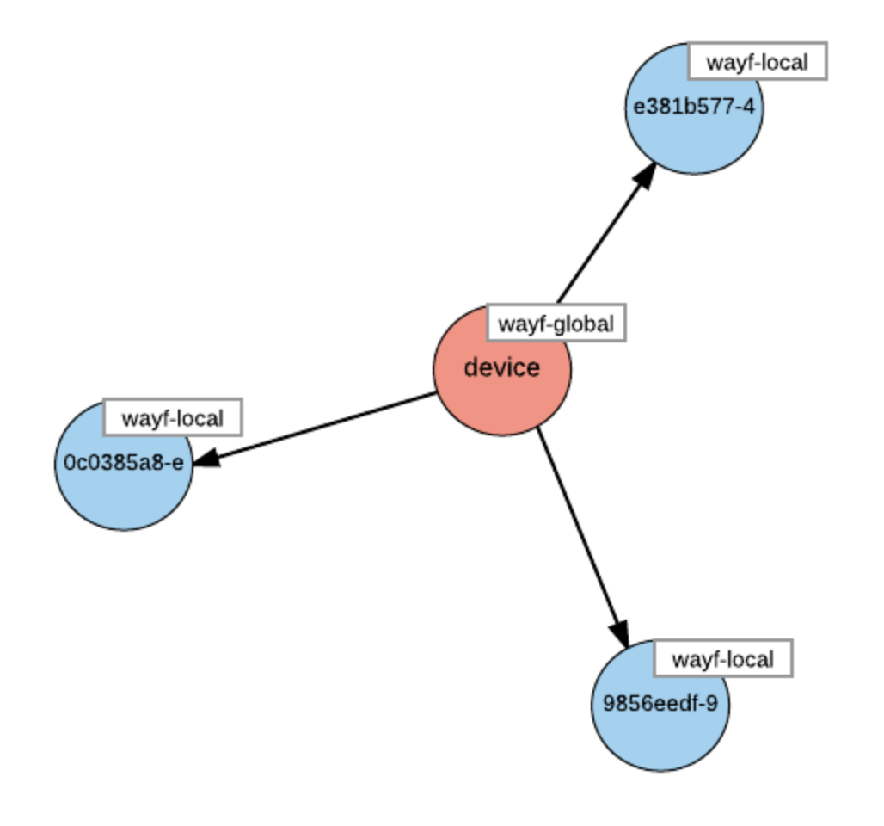
WAYF Cloud Components
WAYF Cloud Widget:
Transfers the unique identifier of the device in the domain of the service provider
Service provider simply incorporates the WAYF Widget URL into relevant HTML pages
WAYF Cloud API
Interface used by the service providers to Create, Discover, Share and keep up to date a user's WAYF history
WAYF Cloud
Centralized service that assigns a global ID to the device and maintains the relationships with the local IDs
The global ID is stored at the device in the form of a cookie and its carried in all requests made by this device (i.e web browser) to the WAYF Cloud server.
Uses the information provided by the WAYF Widget to build relationships between a user's global ID and the different local IDs used by the different service providers for this device
The relationship enables the seamless user experience
Notes:
User visits the web page of the first service provider:
The service provider 1 assigns a local ID for this visitor, and adds the WAYF Widget in the returning page
The service provider at sp1.com uses the API of the WAYF Cloud to Register/Create this local ID to the WAYF Cloud.
The WAYF Widget is executed at the user's web browser, resulting to the assignment of a WAYF global ID to this device and a relationship between the local id.
The user selects an identity provider at sp1.com.
The user's selection is shared by the service provider WAYF Cloud using the API
User visits the second service provider on the same device
The service provider 2 assigns a local ID for this visitor, and adds the WAYF Widget in the returning page
The WAYF Widget is executed again at the user's web browser, and builds an association between sp2's local ID and the WAYF global id
The service provider at sp2.com uses the API of the WAYF Cloud to discover the user's past selection of identity provider
The second service provider can now offer the user the option to Sign In with the same Identity Provider used at the first one, without having to ask the user to manually select it,

Slide 56
WAYF Cloud Challenges
Security/Privacy
Maintaining an open sourced common code base
Operating a shared service

Slide 57
RA21 – Security & Privacy – For all pilots
Privacy Track (non-technical)
Analyze data collected for intended use and storage to ensure compliance with data privacy regulations (GDPR, GLBA, etc.)
Perform privacy impact assessments
Validate privacy controls are commensurate with data values per best practices
Final Results: Recommendations for privacy controls
Security Track (technical)
Assess pilot against information security & web development best practices:
Adherence to W3C web development standards
Secure coding practices
Vulnerability management
Penetration testing
Authentication standards
Final Results: Recommendations for following W3C standards with proper security controls

Slide 58
Operating an open sourced shared service
Development | Run Time
Contributor License Agreement and documented contributing process Copyright ownership Organization to receives the contributions Governance Development process Release process Testing process | How do we know what’s running is what’s on GitHub? Who runs the service? Who takes the responsibility for failure? Who owns the data? How and who manages SLAs (performance, security, privacy, etc.)?
Notes:
Contributor License Agreement and documented contributing process
Who owns the copyright?
What organization receives the contributions?
How to governance the program?
Day-to-day issues—who decides what’s best, what wins, what doesn’t
Code management process
Further/future project creation decisions
Development process
Code review?
Who merges/commits to master?
Release process
Who says it’s ready?
Testing process
How do we prove it works
How often?

Slide 59
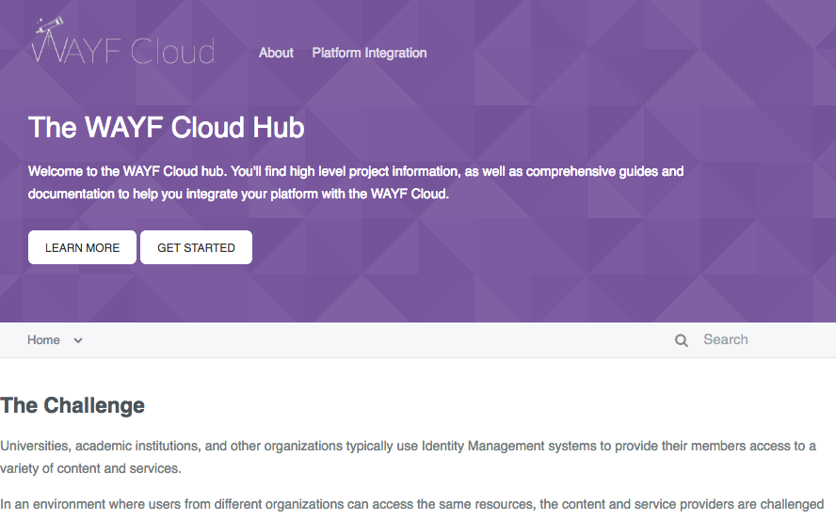
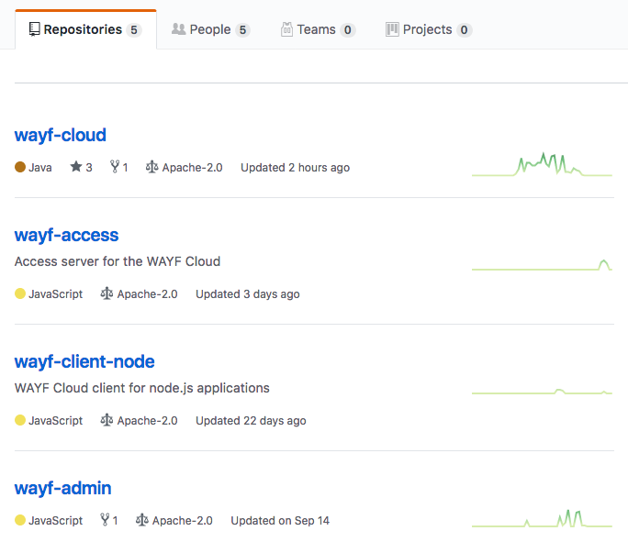
Progress – Development
Open Sourced
Licensed under Apache v2.0
API documentation web-site for vendors interested in integrating with the WAYF Cloud
Notes:
We wrote software following the Opensource development model. The source code available in github under the Apache License

Slide 60
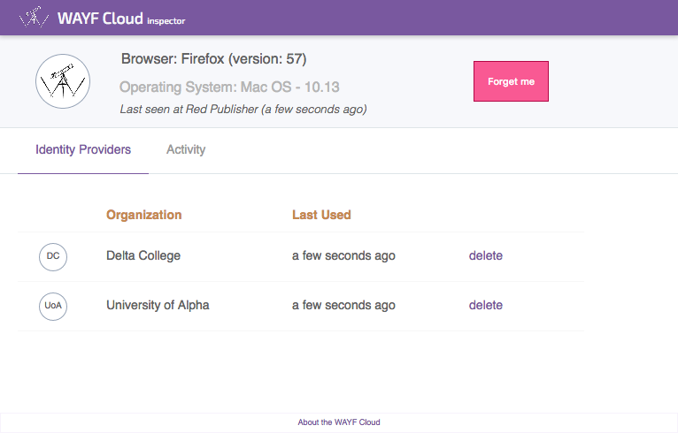
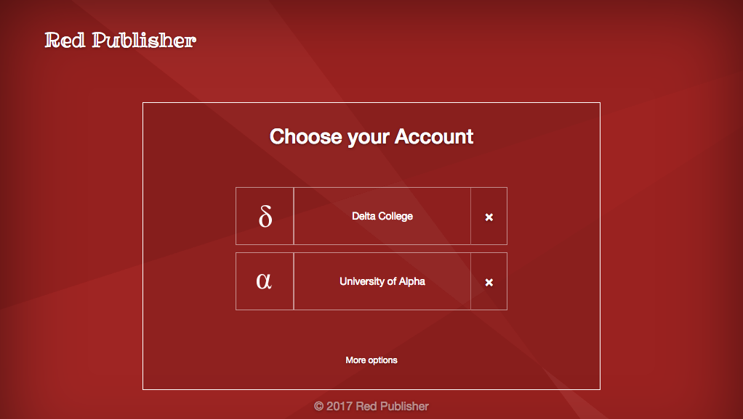
Progress - Sandbox
Sandbox system & working demo
https://wayf-cloud-sandbox.literatumonline.com
Notes:
We have a Sandbox system, and a working demo

Slide 61
Working Groups and Next Steps
Privacy & Security – Face to face workshop on Dec 8th
Interface Specification / Realization
Testing & Usability Evaluation
Operating the shared service
Notes:
We have formed a team of >organizations that help evolve the idea and implementation further
We have created 5 working groups to work on different areas of the project

Slide 62
Questions?

