Slide 1
An Introduction to RA21
Todd Carpenter (NISO)
Robert Kelshian (American University Library)
Don Hamparian (OCLC)
Ann Gabriel (Elsevier)
RA21 Steering Committee
November 10, 2017
Notes:
Good Morning everyone!
My name is Ann Gabriel and I am a Vice President for Academic and Research Relations at Elsevier, an information technology company and publisher member for RA21.
With me is Keith Webster Dean of Libraries for Carnegie Mellon University, as well as Director of Emerging and Integrative Media Initiatives. We are pleased he is able to share his time in presenting to AGLIN, particularly given that before moving for Carnegie Mellon following a brief stint with John Wiley, he was University Librarian and Dean of Libraries for the University of Queensland
Before we begin we would first like to thank everyone involved in the AGLIN forum, especially Anne Lahey and Jan Bordoni for reaching across the globe to learn more and inviting us here today. We especially appreciate the flexibility with the virtual format, and hope all goes well. We are recording this presentation so it will be available afterward, and also happy to circulate the presentation along with the presenters notes as a follow up.
RA21 stands for Resource Access for the 21st Century.
We hope to share with you today a general overview of the project, as well as offer some insight into the pilot projects.
This is a joint effort between STM the global association of STM Publishers and NISO National Information Standards Organization.
So to begin our journey, we would first like to share some scenarios that led to the problem statement and some of the proposed RA21 solutions.

Slide 2
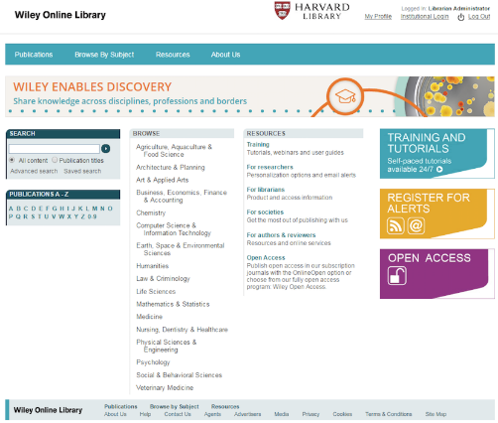
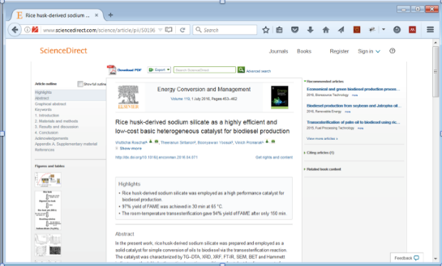
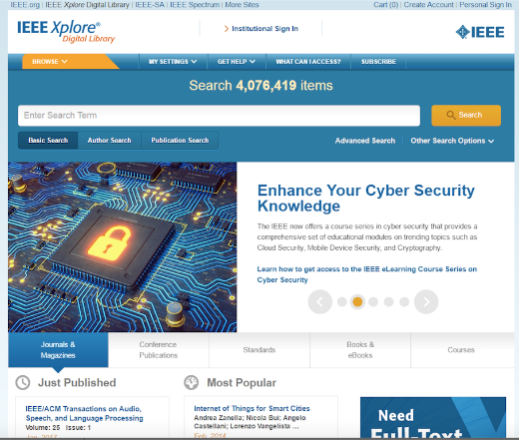
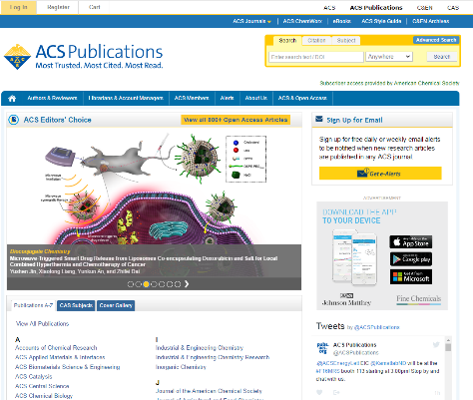
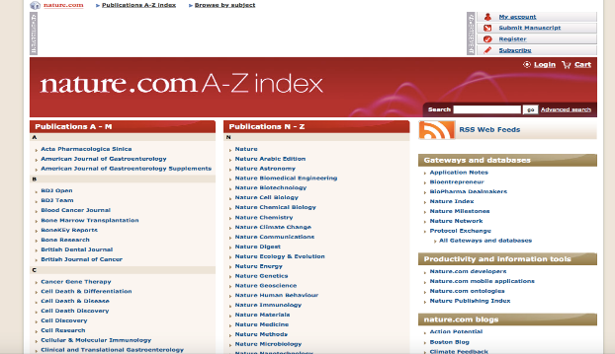
Moving Content From Print to Digital

Slide 3
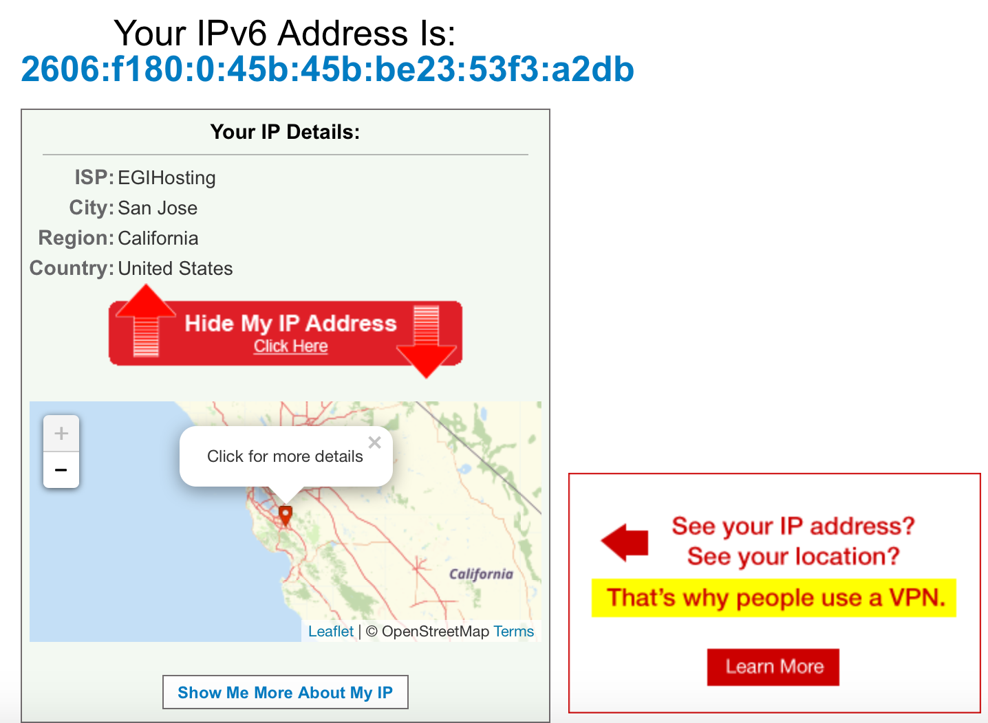
IP -Address Authentication

Slide 4
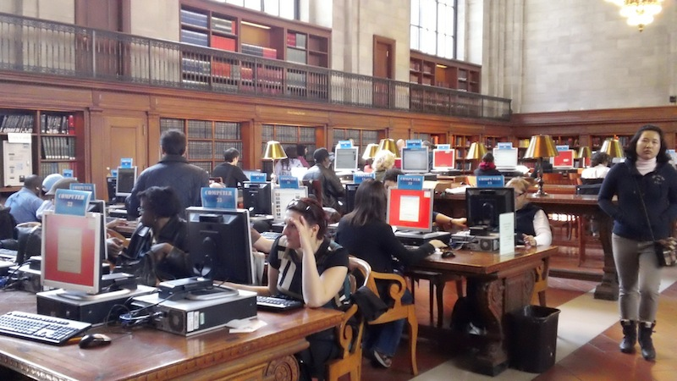
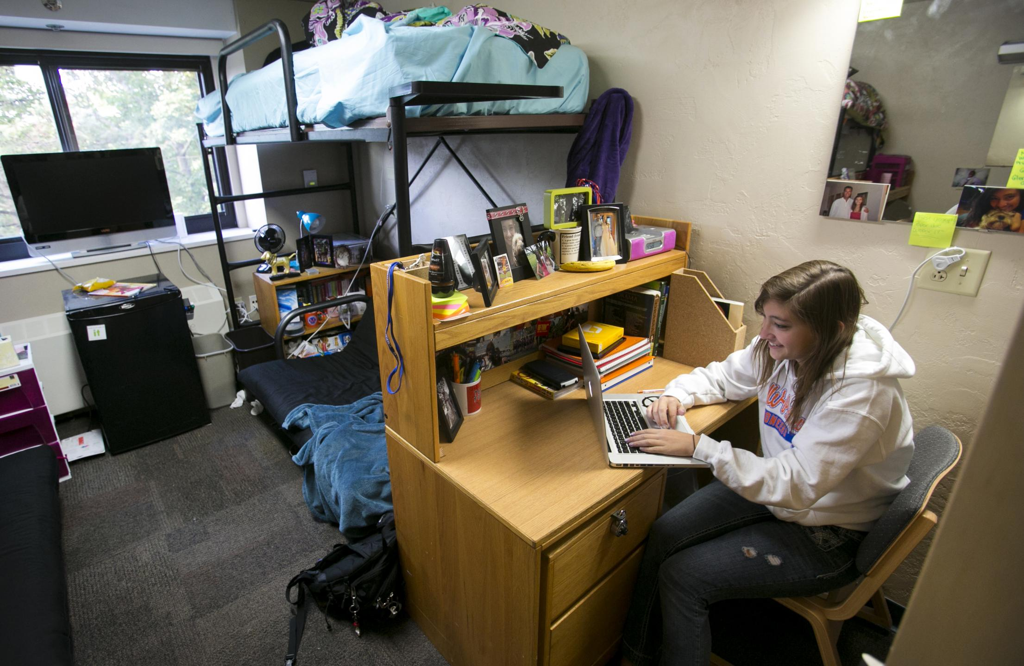
It worked well in this environment

Slide 5
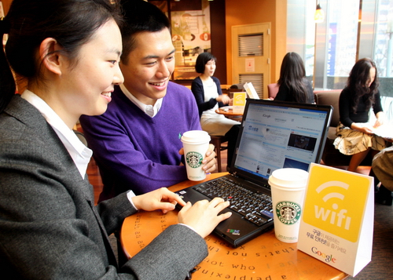
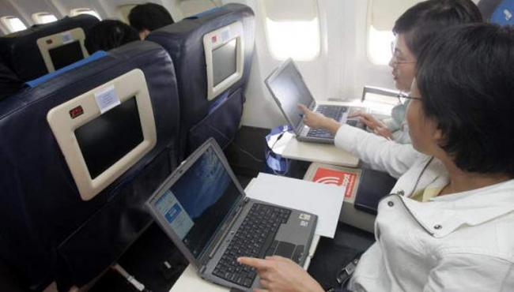
Until, people began connecting from everywhere

Slide 6
IP Address Authentication
FAIL!!!

Slide 7
Librarians are smart!
Proxy Server

Slide 8
These solutions worked well

Slide 9
These solutions worked well
Until they didn’t

Slide 10
Who had their proxy server shut down when a content provider notices unusual activity from that server?
Notes:
Raise your hand if this happens at least once per year? Oncer per semester? Once per month? Anyone have this happen every week?

Slide 11
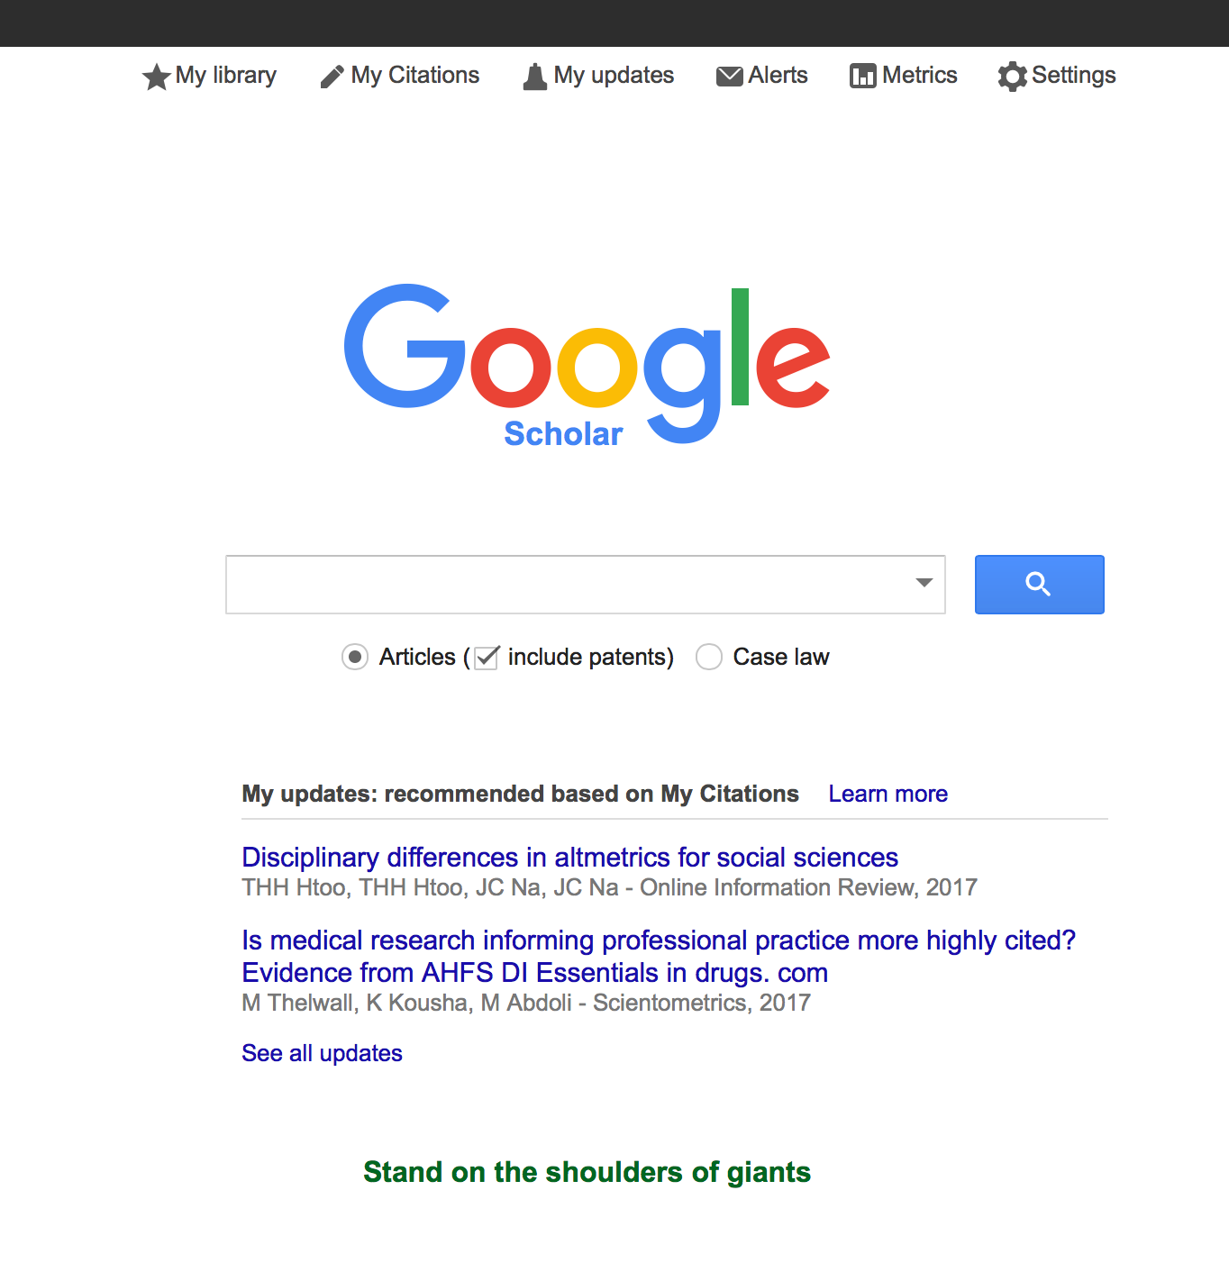
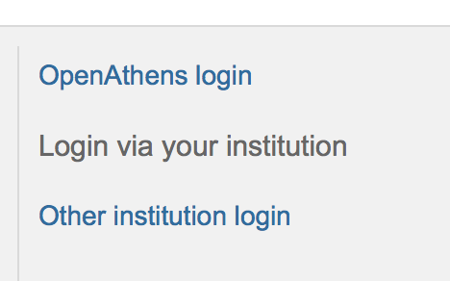
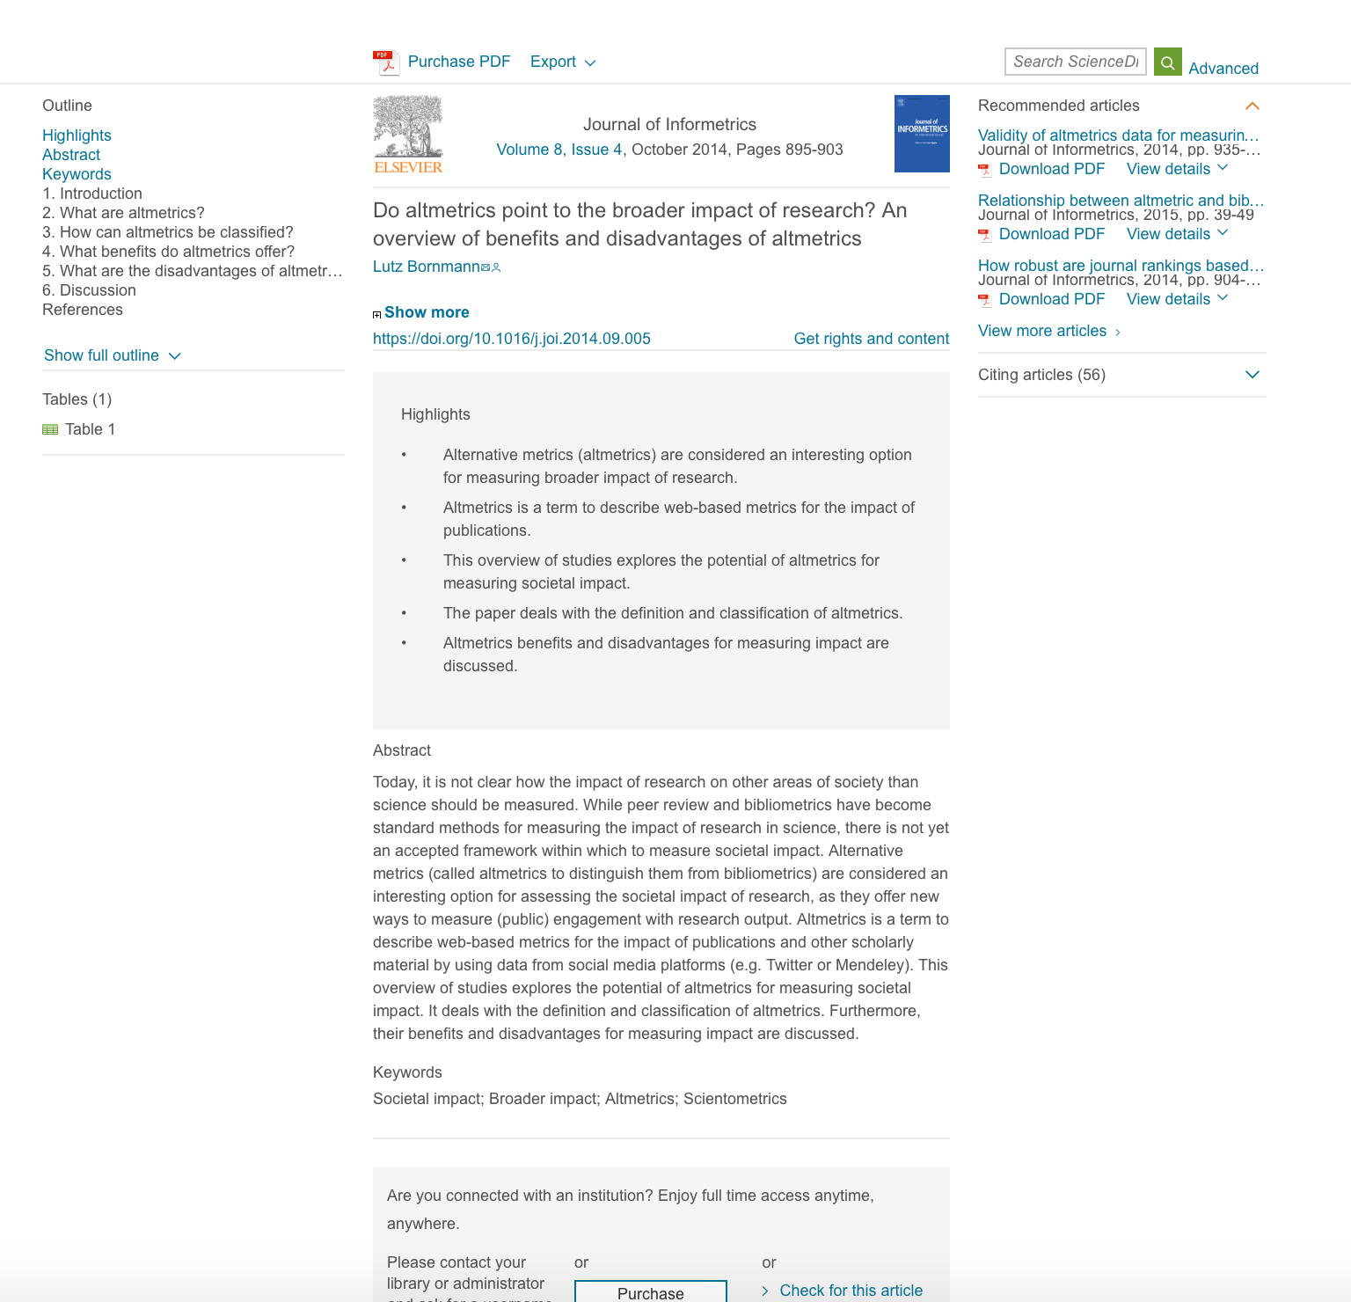
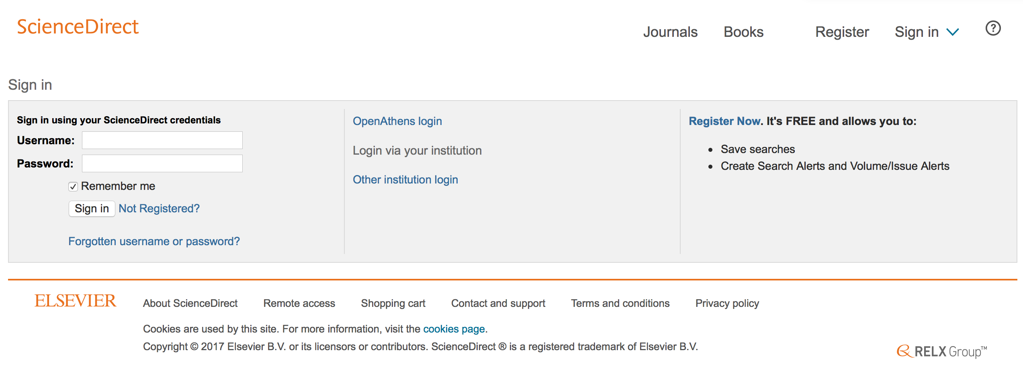
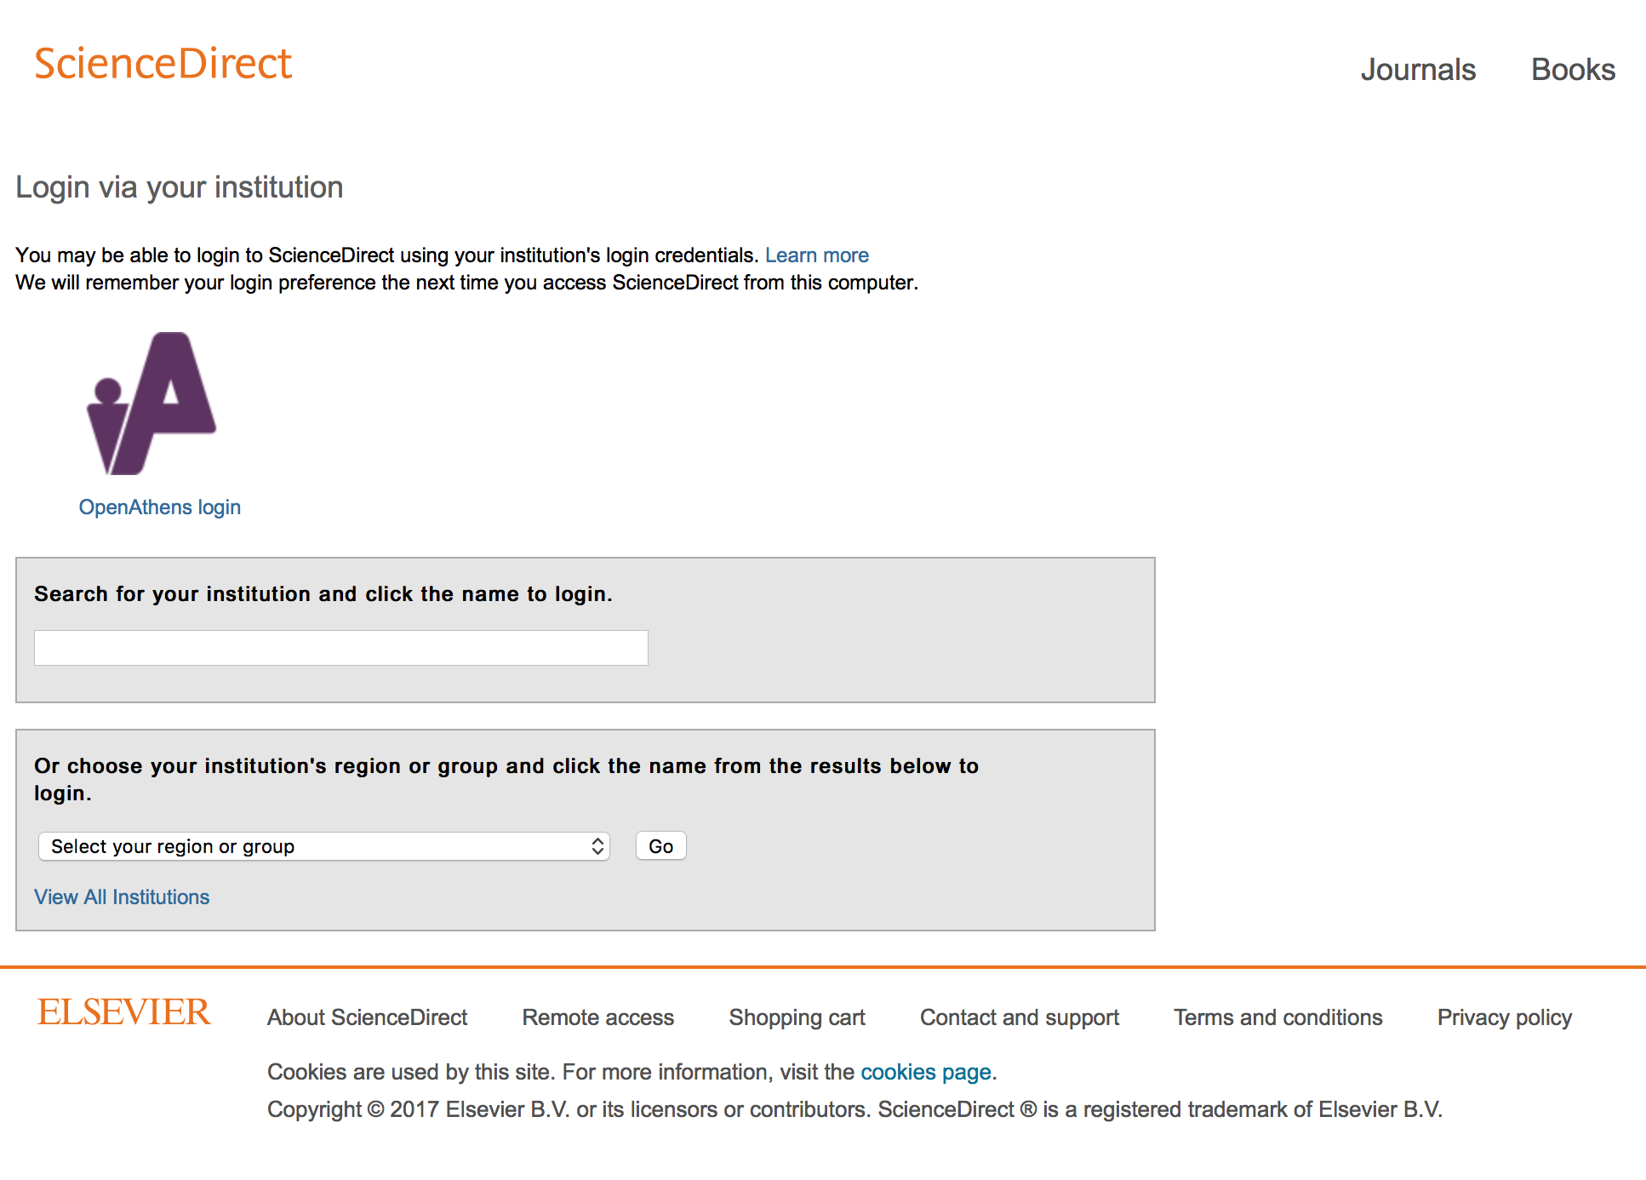
Do you have a login? Yes or No?
Behind the scenes:
Does the user have access rights? Yes or No?
??????
Where are you from?

Slide 12
And patrons are just getting annoyed

Slide 13
All this and no data…
Who is using the content libraries acquire?
Are those user’s getting what they need?
Are they achieving their goals?
Successful in their outcomes?
Are they really secure?
Are they really private?

Slide 15
RA21 Principles: Improve User Experience
From any location on any device
Beginning from any entrance point
Ending with the desired content
With a consistent user interface
With greater privacy, security and personalization

Slide 16
RA21 Principles: It must be open
The solution can not be proprietary
The solution should be (reasonably) easy to implement
The solution must be vendor neutral
Should not create tremendous amounts of new work, implementation cost, or ongoing maintenance.
Should allow for gradual implementation

Slide 17
Pilot program
Pilot program through Q1 2018-ish
Broad spectrum of stakeholders
Address a variety of use cases
Includes both academic and corporate efforts
Self organized, registered and tracked under the larger umbrella of RA21
Feedback and results shared with the community
Ultimate goals
Move away from IP authentication – lack of scale
Balance with the concept of privacy (General Data Protection Regulation 2018)
Create a set of best practice recommendations for identity discovery
Important to have multiple pilots so we can address the problem from multiple angles

Slide 18
RA21 Pilots
Corporate Pilot (Universal Resrource Access “URA”)
Two Academic Pilots
Privacy Preserving Persistent WAYF Pilot
WAYF Cloud Pilot
All seek to address the User Experience for off-campus access
Notes:
So what are the pilots you ask?
We have a Corporate Pilot as well as two academic pilots:
The P3W pilot - Privacy Preserving Persistent WAYF Pilot - quite the tongue twister
And the WAYF Cloud pilot
All seek to address the experience of access outside an institute and to streamline the UX – the user experience – in order to have a similar experience throughout – users do not like to be confronted again and again with new interfaces to master.
So following this bit of context for an introduction, we can now go into a bit of detail on the pilots themselves.

Slide 19
Progress of our corporate pilot…
New user experience flow developed by publishers
Agreed requirements for granular usage statistics
Exploring federation for easy flow between publishers
Notes:
The team have made great progress since the pilots started earlier this year:
The publishers themselves have produced a new user experience workflow, which is about to be tested with pharma endusers
The team have also agreed requirements for granular usage statistics which will be moved forward in the second half of the year; and
The team have also explored a federated flow between publishers – this is more common in academia, but new for pharma. Early SAML testing with individuals was not scalable, so there is hope that a federate structure will be more streamlined.

Slide 20
Privacy Preserving Persistent (P3) WAYF Pilot
Pilot goals
To improve current Shibboleth Identity Provider discovery process
Incorporate additional “WAYF hints” such as email domain and IP address into federation metadata
Improve sign-in flow using those WAYF hints via a shared discovery service
Populate shared discovery service hints from the Service Providers regarding what Identity Providers are likely to work in an authorization scenario
Enable cross-provider persistence of WAYF choice using browser local storage
Pilot participants (confirmed so far)
Project Management GÉANT Educational Access Management Federations Sunet & SWAMiD (Swedish Federation) The samlbits.org project eduGAIN EduServ Publishers Elsevier American Chemical Society | Subscribing institutions MIT University of California, Davis University of Arizona (tbc) University of Florida (tbc) University of Denver (tbc) Service Providers ProQuest Ping LibLynx Ebsco
Notes:
So onto the first of the Academic pilots: the Privacy Preserving Persistent (P3) WAYF Pilot. There are several important things we are trying to investigate in this pilot:
All pilots are addressing the UX in one way or another – If we don’t streamline the UX for authentication, we won’t get endusers to adopt the solution
We want to make sure the identity provider discovery is consistent; we have a multiple of science providers participating – the idea is if an enduser selects your identity with one; they won’t have to repeat for the others; but this sharing of information creates a privacy problem, thus we aim for cross-provider persistence of WAYF choice using browser local storage.
There is a rather large set of folks collaborating on this; originally two pilots combined. It is managed by Geant, and has participation of several access management Federations, Sunet, EduServ are two examples, as well as publishers and subscribing institutions MIT UC Davis, and many well known service providers: ProQuest, LibLynx, Ebsco

Slide 21
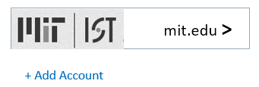
Preserving Privacy
Built upon ”SAML-BITS” technology in production | Technique | Challenge
 | Only domain part of email address needs to be transmitted from browser to publisher platform to select IDP | Need to define and test a standardized UI that makes this clear to users
 | IdP preference is stored locally in the browser, retrieved using centrally served javascript, not on a central server | Need to adapt Account Choose mechanism to support SAML IdPs vs OpenID Connect Authorization Servers
Notes:
So to recap – the P3WAYF pilot would like to make clear to users they only require the domain part of their email (some UX challenges there, but we will solve it), and that their IdP preference is stored locally in the browser, retrieved using centrally served javascript, not on central server.

Slide 22
WAYF Cloud Pilot
Goal
Seamless Access as close to IP Authentication as possible
Eliminate steps which users have to repeat at every publisher
Support for remote access
Methodology
Leverage existing organizational systems/protocols for user authentication
Look to form a potential industry standard for WAYF data exchange
Data Format
Modern Interface Specification
Create an infrastructure for sharing WAYF data amongst publishers. The WAYF Cloud software
embrace OpenSource Software development
easy integration points with service provider platforms
User Interface - Reference design
Notes:
This pilot is actually similar to the PW3 Pilot, but the implementation is different.
The goals are similar to the rest of the pilots:
Seamless Access as close to IP Authentication as possible - go from 6 clicks to zero as much as possible
Eliminate steps which users have to repeat for every publisher
Support for remote access
RA21 are hoping to create a shared infrastructure for sharing WAYF data amongst publishers.
We hope to test out – if we build a shared open infrastructure – how would governance and data formats work?

Slide 23
What is the WAYF Cloud?
publisher platform
What is it?
Data Format Definition
Data Access Interface Specification
Software Component (Free/Opensource)
What does it do?
Allows publishers to exchange information with each other
publisher platform
publisher platform
WAYF Cloud
publisher platform
publisher platform
Notes:
We have built an infrastructure not owned by anybody. The infrastructure will hold a hash key for each user which is mapped through cookies on the users device so users do not have to repeat, and the information gets carried which will allow publishers to exchange information with each other and get close to the IP authentication experience.
So let look at a use case:

Slide 24
Want to get involved?
Visit: https://www.RA21.org
Mailing lists:
P3W community list: https://lists.refeds.org/sympa/subscribe/p3w-community
WAYF Cloud community list: TBD
Everyone: Register your interest in participation by emailing: Julie Wallace: Julia@RA21.org and Heather Flanigan: Heather@RA21.org
Notes:
Thank you for your kind attention. We would love to have you involved with any of the pilots.
While we currently have a lot of active leadership and participation from the US and UK, we are actively seeking greater involvement from Europe and Australasia.
There are a couple of ways you can register your interest: Through our mailing list, or emailing our project leaders directly.
We are also happy to answer any questions off line, or connect with me directly
Ann Gabriel
a.gabriel@Elsevier.com

Slide 25
Contact:
Todd Carpenter
Executive Director
National Information Standards Organization (NISO)
tcarpenter@niso.org
@TAC_NISO

Slide 26
An Academic Library Perspective
What’s the problem that needs solving?
I know through turnaway stats what users want that I don’t have.
I don’t know how often users can’t get to what I do have.
I don’t know every user’s background, experience, and how they navigate.
If I had access to alternatives that provided more robust access and didn’t use them, I would be in trouble.

Slide 27
So many paths to the same end...
Changes in how and who is accessing what:
Large percentage of access is happening from off-campus.
Increase in number of online programs with populations who may never receive library instruction.
Fewer opportunities to find out what I don’t know.
Increasing number of students with whom we never have contact.
Tendency toward judging how user’s navigate
What do you mean they don’t go through the library website?
Are we getting the most for our money if we’re not trying to ensure access at the end of the road?

Slide 28
Security and Privacy
Using Shibboleth as a front layer to EZproxy has worked well for us.
Still counting on user’s to navigate through the website.
We care a lot about privacy. Maybe more than our users do.
Both academic pilots for RA21 have emphasized user privacy as a priority for the project. Additional focus on ease of implementation will be important as the project progresses as well.
Has to be easy to implement to make it a viable option.

Slide 29
Contact:
Rob Kelshian
Director of Access Services
American University Library
calvin@american.edu
Thanks!

Slide 30
November 2017
Charleston: EZproxy and RA21
Don Hamparian
Senior Product Manager, EZproxy and Identity Management,
OCLC

Slide 31
A Quick Show of Hands
Who has experience with:
Using EZproxy to access licensed content?
Administrating EZproxy?
Before this panel, who
knew what:
The RA21 Initiative is?
At your institution:
Does your institution have a SAML-based Authentication system (Shibboleth or CAS)?
Are your library systems integrated?
https://pixabay.com/en/volunteer-hands-help-colors-2055015/

Slide 32
EZproxy and RA21 – OCLC’s Commitment
EZproxy support for standard specifications from RA21
EZproxy enhancements for security features for IP authentication
Compatibility with RA21 SSO schemes and traditional IP authentication
Improving our database configuration process

Slide 33
Securing EZproxy Today
Most common problem (by far) is compromised credentials at the institution
EZproxy is not “hacked”
Four-part strategy to secure access
Protect & Prepare (Proper configuration)
Detect and close compromised credentials
Educate (Provider, Institution Admin, Users)
Collaborate (OCLC, Institution, Provider)

Slide 34
Institution Best Practices – Protect & Prepare
Password Policies
Biggest opportunity – get this done and EZproxy provides a very secure content access path
Require hard-to-guess passwords
Consider Multifactor Authentication (MFA)
Commit resources for EZproxy server management
Exercise detection process before publisher calls you

Slide 35
Institution Best Practices – Protect & Prepare
Keep your evidence (configure log / audit files with data you need) and back them up
Use SSL for authentication and content access where possible
Keep server OS upgraded
Install the current version of EZproxy
Keep your system time correct

Slide 36
Educate & Collaborate
Involving Publishers, OCLC, Libraries
Improve education (staff & patron)
Improve technology
Improve support of our mutual customers
Use OCLC Support Site & Community Center
Your ideas?
https://www.flickr.com/photos/quinnanya/111201180

Slide 37
References
EZproxy Support Site:
https://www.oclc.org/support/services/ezproxy.en.html
Managing your EZproxy: https://www.oclc.org/support/services/ezproxy/documentation/manage.en.html
Securing your server: https://www.oclc.org/support/services/ezproxy/documentation/example/securing.en.html
EZproxy - Publisher Support Page: https://www.oclc.org/support/services/ezproxy/contentproviders.en.html
OCLC Partners Page (Publishers): http://www.oclc.org/en/partnerships.html
RA21 Initiative: https://ra21.org/
http://www.clker.com/clipart-13969.html
Notes:
Improve education
EZproxy and content access management
General securing of credentials
Improve technology
Alerting and notification process
Alternatives to IP authentication
Reporting process
Improve support of our mutual customers
EZproxy database stanza maintenance
General support
Your ideas?

Slide 38
Process – Publisher Perspective
Good discovery experience relies on two things:
Accurately predicting user needs
don’t present more UI than necessary
understand user context
integrate with the web platform
do mobile
Correctly representing the publisher-customer link
don’t disappoint the user
Notes:
From the publisher perspective what we really want to do is to enable the discovery service to be deeply integrated into the publishers sites. We would like to expose suitable APIs within the publisher sign-in flow and learn which service providers work with which ID providers.
A Good discovery experience relies on two things:
Accurately predicting user needs
don’t present more UI than necessary
understand user context
integrate with the web platform
do mobile
Correctly representing the publisher-customer link
make search count
don’t disappoint the user

Slide 39
Process – Publisher Perspective
With User Consent
Publishers will have the opportunity
to provide a better, more customized experience.
Publishers will have the ability to provide granular and differentiated access for better reporting to governing bodies and customers.
Publishers will be able to work with purchasing departments to more carefully manage licensed access and together could quickly target any instances of fraudulent or illegal activity.
RA21 aims to increase the ability of publishers to ensure the integrity of content on both institutional and commercial platforms.
Notes:
From the publisher perspective what we really want to do is to enable the discovery service to be deeply integrated into the publishers sites. We would like to expose suitable APIs within the publisher sign-in flow and learn which service providers work with which ID providers.
A Good discovery experience relies on two things:
Accurately predicting user needs
don’t present more UI than necessary
understand user context
integrate with the web platform
do mobile
Correctly representing the publisher-customer link
make search count
don’t disappoint the user

Slide 40
What about Privacy?
User privacy is one of the guiding principles of RA21
The General Data Protection Regulation and the e-privacy regulation proposal arising from the EU provide act as powerful input to the expectations of the project.
SAML federated authentication technology has in-built mechanisms for preserving privacy.
The institution is fully in control of what personally identifiable information is disclosed to a resource provider
Academic SAML Identity Providers provide unique, persistent, but OPAQUE identifiers
Publishers may then ask for additional personal information from users via their normal registration processes, disclosing their privacy policies.
Notes:
The General Data Protection Regulation and the e-privacy regulation proposal arising from the EU provide a strong set of considerations that act as powerful input to the expectations of the project.
All of the currently proposed pilots make use of SAML federated authentication technology which has in-built mechanisms for preserving privacy.
This puts the institution, and the user, fully in control of what personally identifiable information is disclosed to a resource provider via what are called “attribute release policies”.
Typically, academic SAML Identity Providers provide unique, persistent, but opaque identifiers, which provides a way for publishers to personalize services for users without knowing the actual identity of the individual.
Optionally, publishers may then ask for additional personal information from users via their normal registration processes, disclosing their privacy policies, in order to provide services which require the publisher to know the identity of the user, such as email alerts.

Slide 41
Outreach Activities
CNI - December 2016, April 2017
STM - December 2016, July 2017, December 2017
SSP - May 2017
JISC - July 2017
AGLIN Forum - August 2017
SURF - September 2017 Utrecht
Internet2 - October 2017 San Francisco
Charleston Conference - November 10, 2017
UKSG - November 16, 2017
CCC - hosted webinar November 16, 2017
ALA Midwinter - January 20-24, 2018 Denver
PSP - February 7-9, 2018 DC
MLA - May 18-23, 2018, Atlanta
SSP - May 30 - June 1, 2018, Chicago
RA21 in the News
UKSG Insight – Opinion Pieces: “Easy access to the version of record (VoR) could help combat piracy: views from a publishing technologist” Author: Tasha Mellins-Cohen. 10 July 2017.
Society for Scholarly Publishing – Scholarly Kitchen: “Failure to Deliver: Reaching Users in an Increasingly Mobile World” Author: Todd Carpenter. 15 June 2017.
Library Learning Space: “RA21 and libraries” 16 May 2017.
Index Data: “RA21 Project aims to ease remote access to licensed content” Author: Peter Murray. 19 December 2016.
Notes:
The General Data Protection Regulation and the e-privacy regulation proposal arising from the EU provide a strong set of considerations that act as powerful input to the expectations of the project.
All of the currently proposed pilots make use of SAML federated authentication technology which has in-built mechanisms for preserving privacy.
This puts the institution, and the user, fully in control of what personally identifiable information is disclosed to a resource provider via what are called “attribute release policies”.
Typically, academic SAML Identity Providers provide unique, persistent, but opaque identifiers, which provides a way for publishers to personalize services for users without knowing the actual identity of the individual.
Optionally, publishers may then ask for additional personal information from users via their normal registration processes, disclosing their privacy policies, in order to provide services which require the publisher to know the identity of the user, such as email alerts.

Slide 42
RA21 Position Paper
Still in DRAFT
Audience: Identity Providers and Federation Operators
Topic: Metadata Extensions and Session Management recommendations
Goal: areas that identity providers and federation operators can work on today to immediately start improving the user’s identity discovery experience
Notes:
From the publisher perspective what we really want to do is to enable the discovery service to be deeply integrated into the publishers sites. We would like to expose suitable APIs within the publisher sign-in flow and learn which service providers work with which ID providers.
A Good discovery experience relies on two things:
Accurately predicting user needs
don’t present more UI than necessary
understand user context
integrate with the web platform
do mobile
Correctly representing the publisher-customer link
make search count
don’t disappoint the user

Slide 43
Pilot Participation
Agreed goals:
Working demoable system, with publisher platforms integrated with the WAYF Cloud
A public Github repository with the source of the WAYF Cloud with an Open Source License
A report with the results from user testing
A set of recommendations for the governance and other operational aspects of the WAYF Cloud
Notes:
What are the deliverables?
While not a bespoke solution the team are working toward a demoable system, with publisher platforms integrated with the WAYF Cloud.
Further aims include:
A public Github repository with the source of the WAYF Cloud with an Open Source License
A report with the results from user testing
A set of recommendations for the governance and other operational aspects of the WAYF Cloud

Slide 44
Who’s Involved
Constituted as a joint NISO/STM initiative
Initial funding provided by participating publishers
Two dedicated staff brought on board to drive pilots:
Steering community with stakeholders from library, vendor and identity management communities:
Chris Shillum, Elsevier (Co-chair)
Meltem Dincer, Wiley (Co-chair)
Gerry Grenier, IEEE
Laird Barrett, Springer Nature
Ralph Youngen, American Chemical Society
Dan Ayala, Proquest
Don Hamparian, OCLC
Leif Johansson, SUNet
Ann West, InCommon
Andy Sanford, Ebsco
Josh Howlett, Jisc
Rich Wenger, MIT
Peter Brantley, UC Davis
Library Representative (name TBA soon)
Todd Carpenter, NISO representative
Eefke Smit, STM representative
Ann Gabriel, Elsevier (Chair, RA21 Outreach and Communications Committee)
Julia Wallace
Program Director
Julia@RA21.org
Heather Flanagan
Project Coordinator
Heather@RA21.org
Notes:
And involvement of multiple stakeholders is in an of itself a guiding principle.
There is a chain of parties involved in access and authentication, and if we don’t solve these problems together, solutions will never work.
We are including people from the library world, vendors, and identity management communities. You see here the list of members on the RA21 steering committee, but there is also an outreach committee, which I chair; and we are in the process of forming an advisory committee for the project. We still have a few seats free so if you are interested, please feel free to reach out following the AGLIN forum to make yourself known.
RA21 has some funding for a Program Director, in this case Julia Wallace, who is based in the UK and for whom we are grateful; and also the very necessary Heather Flanagan, our project coordinator, who is managing many of the logistics around the pilots which we will discuss shortly.

Slide 45
QUESTIONS???
Thank you!

Slide 46
Appendix: Different approaches: RA21 / CASA
 | CASA | RA21
Initial setup & periodic re-setup | User must be on site or remotely logged in via VPN (or proxy?) to establish the relationship between an institutional IP address and the user’s Google account or browser. This relationship expires (after 7 days?) and so this process must be repeated for continued access. | No initial setup; can access content from both on- and off-campus right from the start No periodic re-setup required, access continues as long as institution allows.
Seamless authentication | If the CASA-anticipated workflow is followed (start on campus, then go off with same device/browser), access is seamless until tokens expire - then user must get back on campus or vpn/proxy | The user needs to log into school’s identity provider to access content (so a bit less seamless than CASA), but they often already will be (to use other school systems), and IDPs typically allow continued access for a time based on cookies.
Authorization / Entitlements | IP address recognition, leveraging IPs registered with Google’s Subscriber Links program - so typically one fixed set of entitlements per organization. | Leverages identity federation technology, which ensures that authorized users have access to entitled resources regardless of physical location. Easy to grant different entitlements to different users/groups.
Personalization | Requires users to log into a publisher site with a separate username and password in order to access personalized services | No separate login credentials required for personalization; SAML provides each SP with a distinct, opaque, unique ID for each user that is not correlated to their personal identity Users may also consent to provide publishers with personal information in order to access additional personalized services without requiring a separate login/password. Identity attributes can be leveraged to enhance personalization options (e.g. student vs. faculty roles).
Privacy | Provides a separate token to SP for each article; user is anonymous to SP. Token contains timestamp, institutional id, and random number (to make token unique.) No IP info in token, avoids propagating specific previous user locations. Unclear what data is collected by Google, if limited to Google Scholar or used as other Google data collection (e.g. ads) No defined way for a user to opt-out of receiving the token when they visit Google Scholar from an accepted IP address. | Based upon privacy preserving protocols which allow for explicit user consent for transmission of personal information. Can leverage per-SP opaque & unique identifier for user that allows for personalization without giving any personal information to service provider. Identifier for the same user is distinct across different SPs, to further protect user privacy.
Portability | Access only on a given browser/device combination, unless the user remembers to also sign into a google account while on-campus, and then also on other devices. | Access is always portable to any browser or device the patron uses; the user doesn’t need to take any special preparatory steps
Standards and SP implementation | Currently based on proprietary mechanism that would need to be implemented at each publisher/SP. | Based on mature, open, SAML standards that many publishers/SPs already support.
Availability | Currently only available on Google Scholar, not Google web search or any other discovery / search systems or systems on the open web. Furthermore, only works if the publisher also supports Google Subscriber Links. | Works when coming to the library or service provider site from any location on the web. Only requirement is for library and service provider to support SAML SSO (N.B. This will be easier in Americas/Europe, but less prevalent in Asia/Africa)
Security of Content | Does nothing to eliminate value of on-network proxies and other content-theft mechanisms that are used today. Remains difficult to track down to an individual actor. | Tracks usage to an individual actor, allowing blocking to be done in targeted manner when fraud occurs. Also ties access to a credential with other significant value to its owner beyond the content (e.g. payroll, grades, benefits) so less likely to be shared with fraudsters. Also benefits from security/protection/monitoring given to enterprise credentials by institution.
Notes:
What are the deliverables?
While not a bespoke solution the team are working toward a demoable system, with publisher platforms integrated with the WAYF Cloud.
Further aims include:
A public Github repository with the source of the WAYF Cloud with an Open Source License
A report with the results from user testing
A set of recommendations for the governance and other operational aspects of the WAYF Cloud

