Slide 1
An Introduction to RA21
Jisc
London
7 July 2017

Slide 2
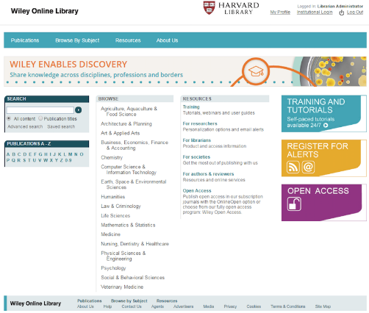
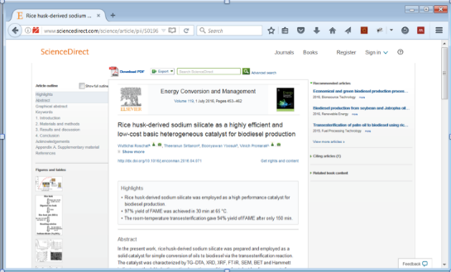
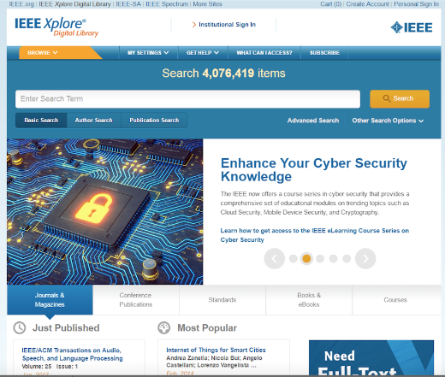
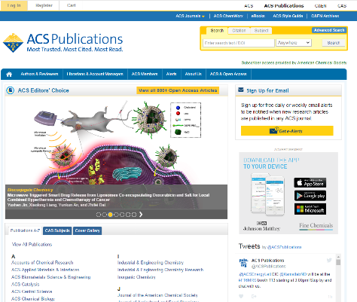
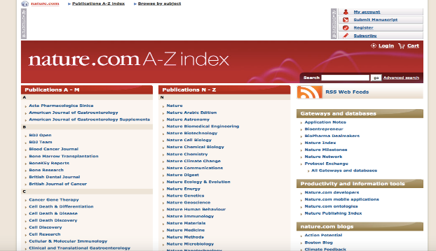
Late 20th Century: from Print to Digital
Institution to purchase from the publisher
Institution to lend to its users
Single point of entry
Simple transaction
Library cards
Lock the doors at night
Must return after use
Prohibitively expensive to make copies of entire collections
Imitate print experience
Optimize for ease of implementation
IP address recognition

Slide 3
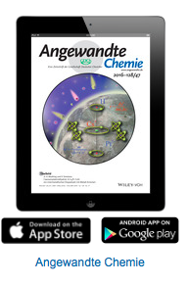
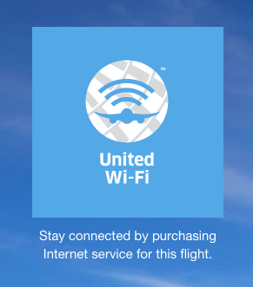
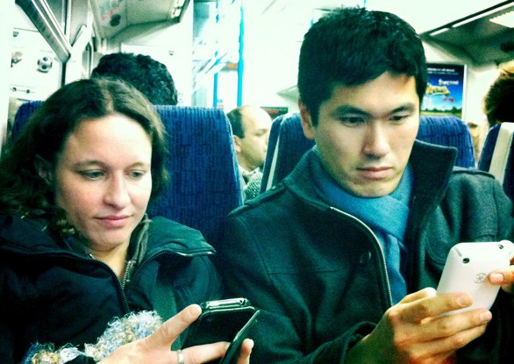
21st Century: digital and remote
Technology evolved
Multiple entry points
Mobile and remote access
Cumbersome user experience
Easy to download an entire library

Slide 4
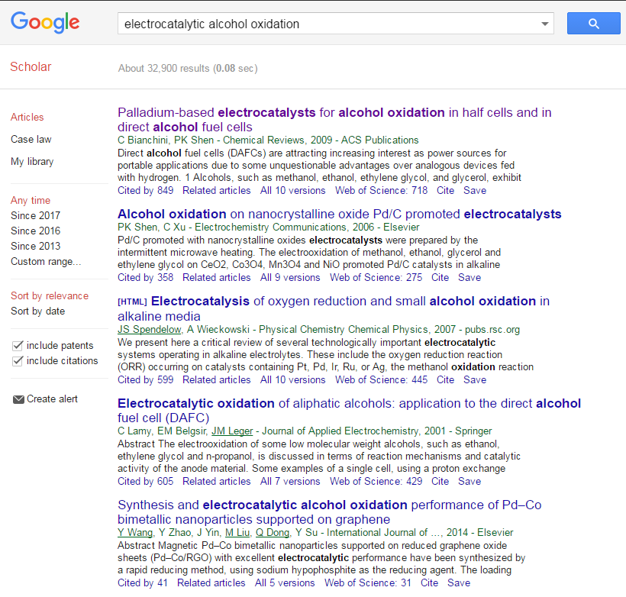
How a user experiences access to resources on campus
1

Slide 5
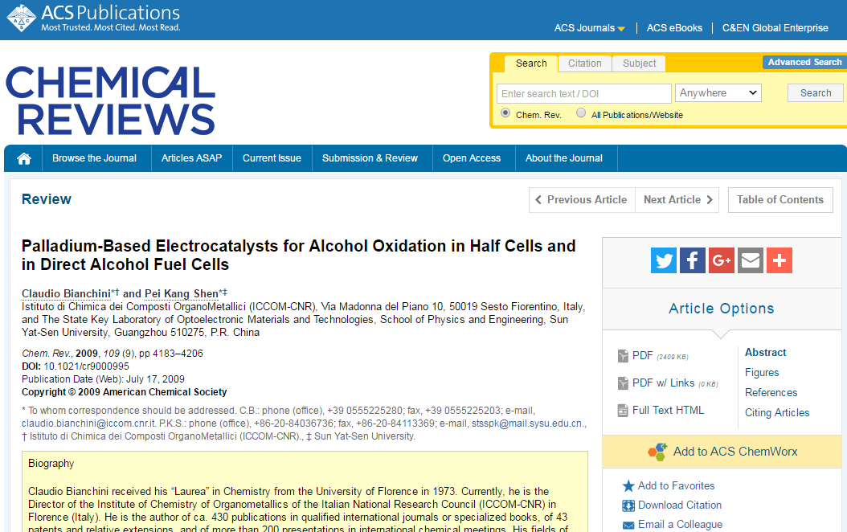
How a user experiences access to resources on campus
2

Slide 6
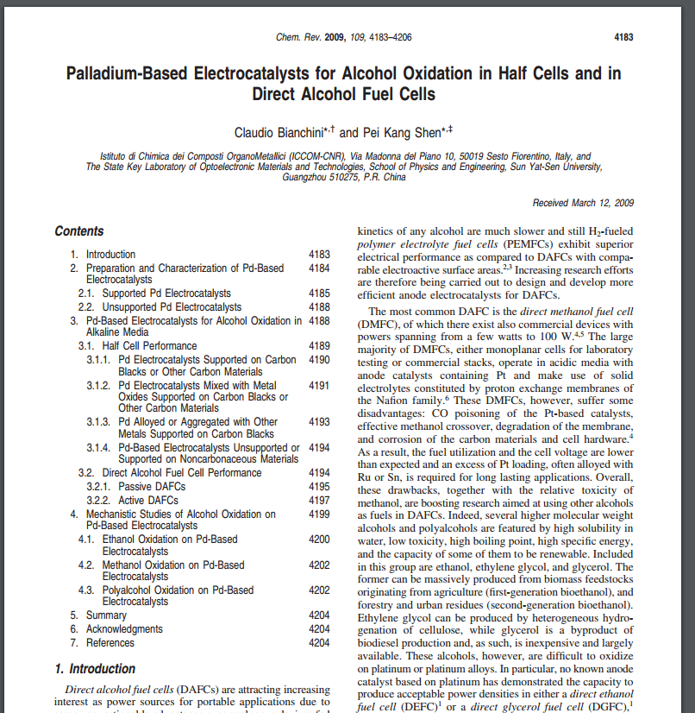
How a user experiences access to resources on campus
✓
2

Slide 7
How a user experiences access to resources off campus
1

Slide 8
How a user experiences access to resources off campus
2

Slide 9
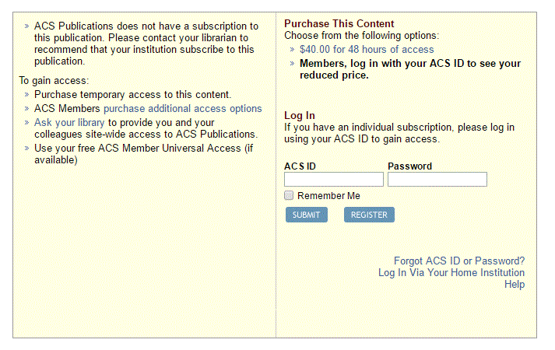
How a user experiences access to resources off campus
3

Slide 10
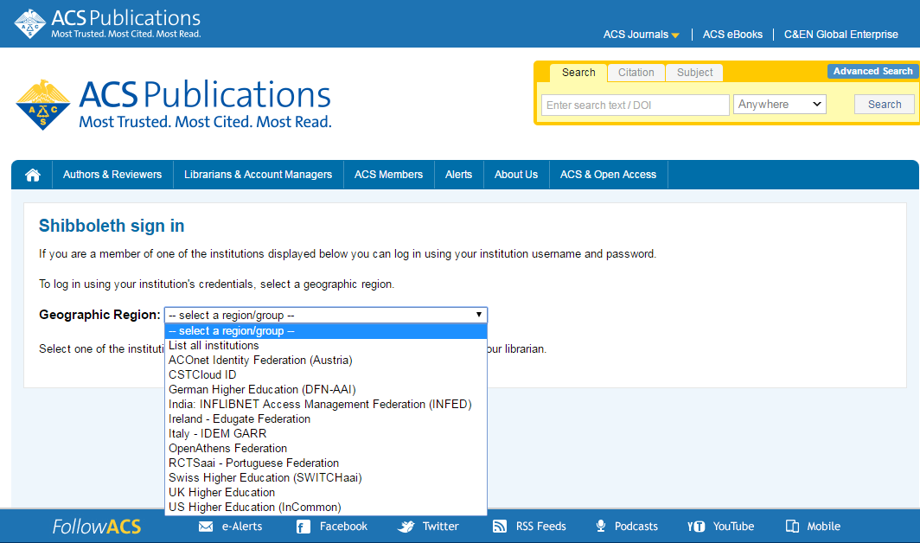
How a user experiences access to resources off campus
4

Slide 11
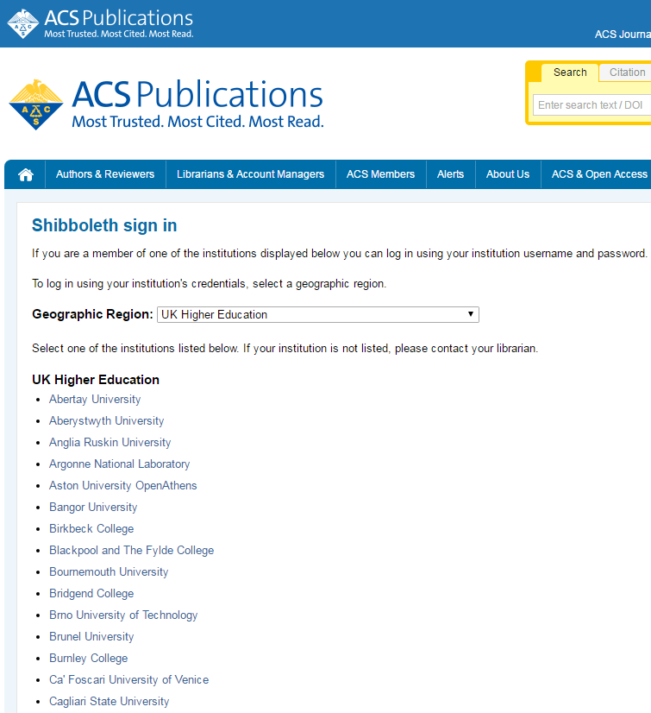
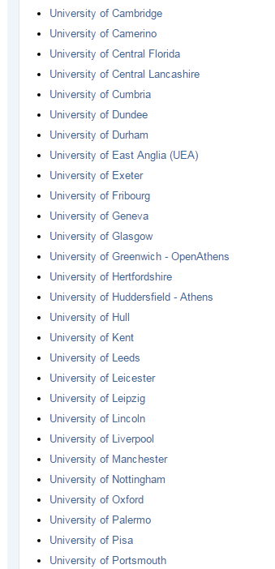
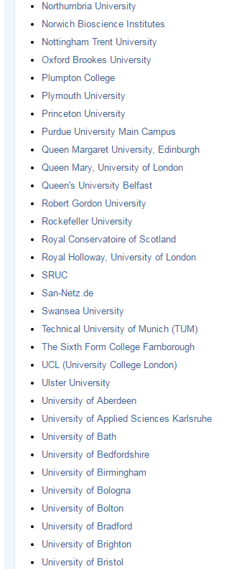
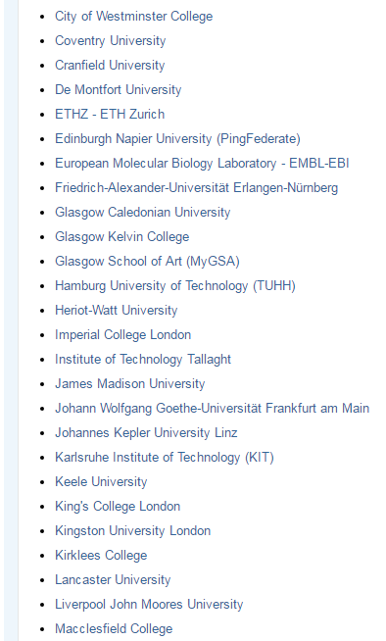
How a user experiences access to resources off campus
5

Slide 12
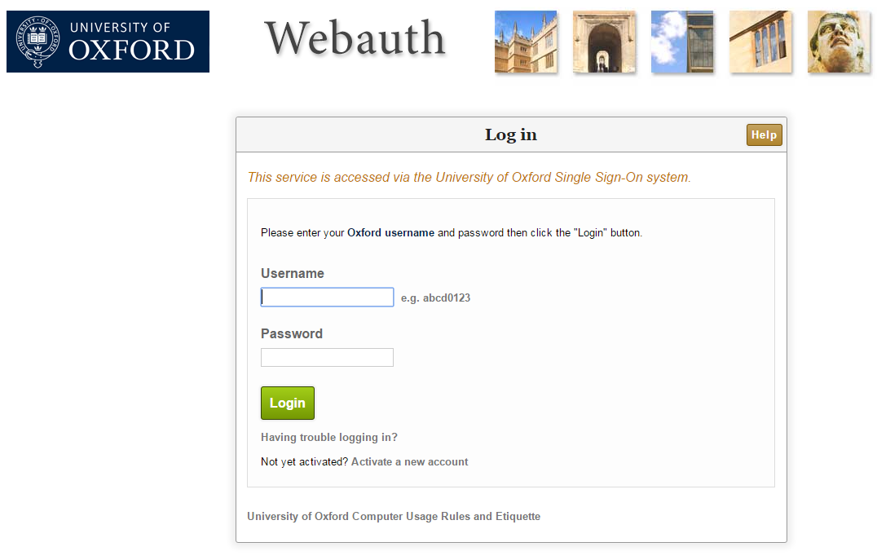
How a user experiences access to resources off campus
6

Slide 13
How a user experiences access to resources off campus
✓
6

Slide 14
RA21 Problem Statement
Access to STM content and resources is traditionally managed via IP address recognition.
For the past 20 years, this has provided seamless access for users when on campus
However, with modern expectations of the consumer web, this approach is increasingly problematic:
Users want seamless access from any device, from any location
Users increasingly start their searches on 3rd party sites (e.g. Google, PubMed) rather than publisher platforms or library portals and run into access barriers
A patchwork of solutions exist to provide off-campus access: proxy servers, VPNs, Shibboleth, however the user experience is inconsistent and confusing
Publishers are facing an increasing volume of illegal downloads and piracy, and fraud is difficult to track and trace because of insufficient information about the end user
The lack of user data also impedes the development of more user-focused, personalized services by publishers.
The increase in privacy and fraud also poses a significant risk to campus information security

Slide 15
RA21 Guiding Principles
The user experience for researchers will be as seamless as possible, intuitive and consistent across varied systems, and meet evolving expectations.
The solution will work effectively regardless of the researcher’s starting point, physical location, and preferred device.
The solution will be consistent with emerging privacy regulations, will avoid requiring researchers to create yet another ID, and will achieve an optimal balance between security and usability.
The system will achieve end-to-end traceability, providing a robust, widely adopted mechanism for detecting fraud that occurs at institutions, vendor systems, and publishing platforms.
The customer will not be burdened with administrative work or expenses related to implementation and maintenance. The implementation plan should allow for gradual transition and account for different levels of technical and organizational maturity in participating institutions.

Slide 16
Who’s Involved
Constituted as a joint NISO/STM initiative
Initial funding provided by participating publishers
Two dedicated staff brought on board to drive pilots:
Steering community with stakeholders from library, vendor and identity management communities:
Chris Shillum, Elsevier (Co-chair)
Meltem Dincer, Wiley (Co-chair)
Gerry Grenier, IEEE
Laird Barrett, Springer Nature
Ralph Youngen, American Chemical Society
Dan Ayala, Proquest
Don Hamparian, OCLC
Leif Johansson, SUNet
Ann West, InCommon
Andy Sanford, Ebsco
Josh Howlett, Jisc
Rich Wenger, MIT
Peter Brantley, UC Davis
Library Representative (name TBA soon)
Todd Carpenter, NISO representative
Eefke Smit, STM representative
Ann Gabriel, Elsevier (Chair, RA21 Outreach and Communications Committee)
Julia Wallace
Program Director
Heather Flanagan
Project Coordinator
Julia@RA21.org
Heather@RA21.org

Slide 17
Federated Identity Management Technology
Technology exists today that can provide for more secure interactions
SAML-based authentication
Shibboleth in widespread use throughout academia
SAML solutions from Oracle, Microsoft, Ping Identity, etc. widely used in corporate space
SAML attributes provide flexibility regarding privacy while also offering enhanced capabilities
Pseudonym vs. personally identifiable information
Department codes
Student/faculty/staff roles

Slide 18
Federated Identity and Privacy
A service provider does not necessarily see anything beyond “yes this person successfully authenticated”
Any additional information is subject to negotiation between the organization and the service provider
Privacy regulations (e.g., GDPR) actively dissuade service providers from wanting to hold and mine any data from these transactions

Slide 19
Developing Best Practice
Right ways and wrong ways to promote federated identity
Identity Discovery is the particularly thorny problem
RA21 will develop best practice based on actual experience via pilot programs

Slide 20
Pilot program
Pilot program through Q4 2017
Broad spectrum of stakeholders
Address a variety of use cases
Includes both academic and corporate efforts
Self organized, registered and tracked under the larger umbrella of RA21
Feedback and results shared with the community
Ultimate goals
Move away from IP authentication – lack of scale
Balance with the concept of privacy (General Data Protection Regulation 2018)
Create a set of best practice recommendations for identity discovery
Important to have multiple pilots so we can address the problem from multiple angles
RA21 will not build a specific technical solution or an industry-wide authentication platform

Slide 21
RA21 Pilots
Corporate Pilot
Two Academic Pilots
Privacy Preserving Persistent WAYF Pilot
WAYF Cloud Pilot
All seek to address the User Experience for off-campus access

Slide 22
RA21 Corporate Pilot
Helen Malone
Director, Global Information Hub
GlaxoSmithKline (GSK)

Slide 23
Why do we need to move beyond IP…?
Respond to internal company restructuring (eg mergers & divestments)
Provide external (off-network) corporate access on any device

Slide 24
Not on the corporate network…
Start at Publisher Website
Registered User
Institutional Access

Slide 25
Objectives for our corporate pilot…
Improve the user experience at publisher sites
Explore ways to capture granular usage statistics
Consider options for easy flow between publishers

Slide 26
Corporate Pilot: Pharma Companies & Publishers
RA21

Slide 27
Progress of our corporate pilot…
New user experience flow developed by publishers
Agreed requirements for granular usage statistics
Exploring federation for easy flow between publishers

Slide 28
Our scientists need us…
…to closely collaborate on a solution for it to become a reality

Slide 29
Privacy Preserving Persistent (P3) WAYF Pilot
Pilot goals
To improve current Shibboleth Identity Provider discovery process
Incorporate additional “WAYF hints” such as email domain and IP address into federation metadata
Improve sign-in flow using those WAYF hints via a shared discovery service
Populate shared discovery service hints from the Service Providers regarding what Identity Providers are likely to work in an authorization scenario
Enable cross-provider persistence of WAYF choice using browser local storage
Pilot participants (confirmed so far)
Project Management GÉANT Educational Access Management Federations Sunet & SWAMiD (Swedish Federation) The samlbits.org project eduGAIN EduServ Publishers Elsevier American Chemical Society | Subscribing institutions MIT University of California, Davis University of Arizona (tbc) University of Florida (tbc) University of Denver (tbc) Service Providers ProQuest Ping LibLynx Ebsco

Slide 30
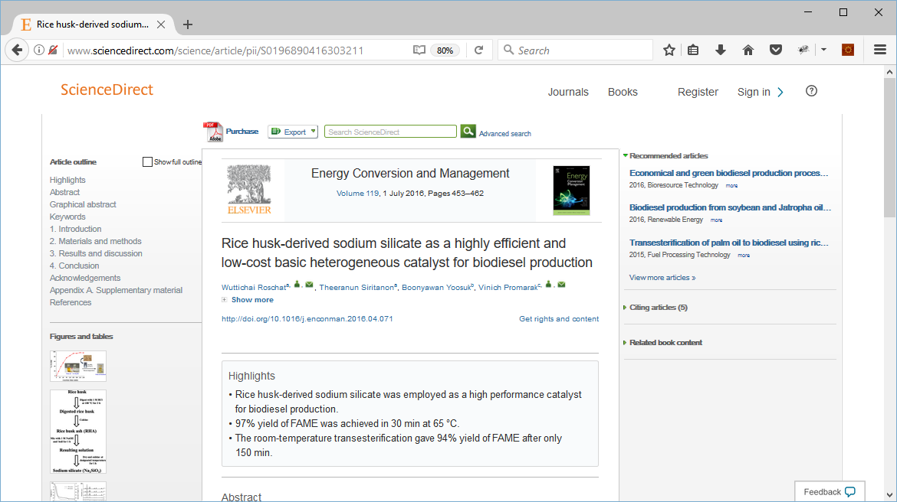
Improved First-Time Flow – Step 1
Enter your institutional email or domain to check access
Email address*
a.professor@mit.edu
X Remember this account
Continue
*Your email address will not be stored

Slide 31
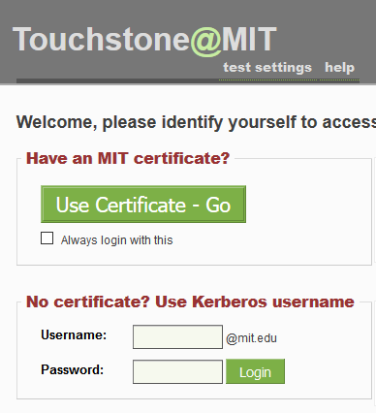
Improved First-Time Flow – Step 2

Slide 32
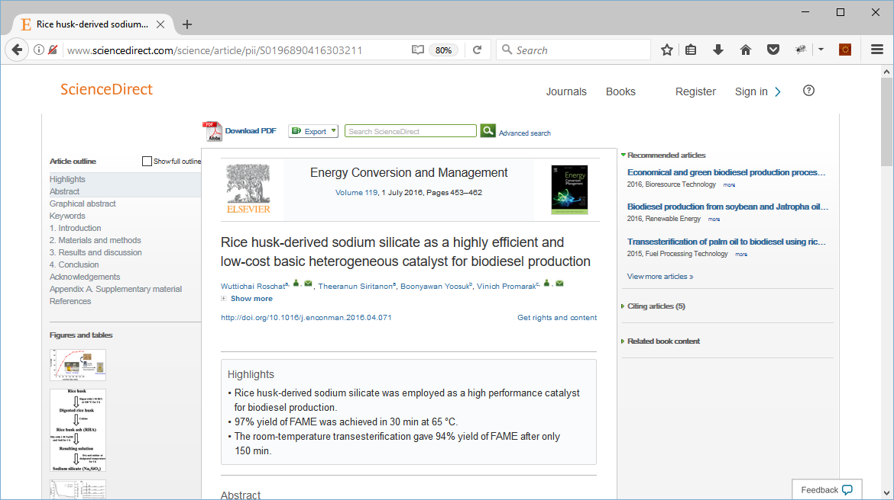
Improved First-Time Flow – Step 3

Slide 33
Improved Next-Time Flow – Step 1
Chose an account to check access
mit.edu >
+ Add Account

Slide 34
Improved Next-Time Flow – Step 2

Slide 35
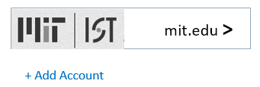
Preserving Privacy
 | Technique | Challenge
 | Only domain part of email address needs to be transmitted from browser to publisher platform to select IDP | Need to define and test a standardized UI that makes this clear to users
 | IdP preference is stored locally in the browser, retrieved using centrally served javascript, not on a central server | Need to adapt Account Choose mechanism to support SAML IdPs vs OpenID Connect Authorization Servers

Slide 36
Achieving the vision
Objective | Work for Core Team* | Work for Participating Libraries | Work for Participating Publishers
Incorporate additional “WAYF hints” federation metadata | Agree schema for WAYF hints | Add new attributes to IdP metadata | Read new attributes from IdP metadata
Improve sign-in flow using those WAYF hints | Design new UI flow (can borrow and adapt from URA pilot) | Test new UI flow with end users and collected feedback | Implement new UI flow in platform (at least as a prototype)
Enable cross-provider persistence of WAYF choice using browser local storage | Adapt Account Chooser javascript Host modified Account Chooser javascript | Educate users | Incorporate Account Chooser into UI flow (at least as a prototype)
* Core team = Vendors, Publishers and Libraries interested in defining the UX and building the technology for this pilot

Slide 37
Process – user perspective
Step one: discovery service checks the browser’s local store and displays the last IdP (or set of IdPs) used by the user.
Step two: if the local browser store is empty, or if the user chooses not to use any of the IdPs offered, the user will be presented with a search interface or a list that is built based on the database of IdPs that will be known to work with that SP (the samlbits component)

Slide 38
Process – Publisher Perspective
Good discovery experience relies on two things:
Accurately predicting user needs
don’t present more UI than necessary
understand user context
integrate with the web platform
do mobile
Correctly representing the publisher-customer link
make search count
don’t disappoint the user

Slide 39
Process – Library Perspective
Libraries might be the IdP
then they don’t have to do anything other than be an IdP
Libraries are going to be critical for the UX guidance
the UI needs to be better at displaying IdPs that are NOT known to work with an SP

Slide 40
WAYF Cloud Pilot
Meltem Dincer, Wiley
Elias Balafoutis, Atypon
Colleen Finley, Wiley

Slide 41
WAYF Cloud Pilot
Goal
Seamless Access as close to IP Authentication as possible
Eliminate steps which users have to repeat at every publisher
Support for remote access
Methodology
Leverage existing organizational systems/protocols for user authentication
Look to form a potential industry standard for WAYF data exchange
Data Format
Modern Interface Specification
Create an infrastructure for sharing WAYF data amongst publishers. The WAYF Cloud software
embrace OpenSource Software development
easy integration points with service provider platforms
User Interface - Reference design

Slide 42
What is the WAYF Cloud?
publisher platform
What is it?
Data Format Definition
Data Access Interface Specification
Software Component (Free/Opensource)
What does it do?
Allows publishers to exchange information with each other
publisher platform
publisher platform
WAYF Cloud
publisher platform
publisher platform

Slide 43
Main Use Case
Lisa
college student is currently off campus, at her local coffee shop
She finds a paper of interest from the “Awesome Publisher Inc”
“Awesome Publisher” participates in the WAYF Cloud
This is Lisa’s first time at the “Awesome Publisher”
Lisa has visited other publisher sites in the past with her Institutional credentials

Slide 44
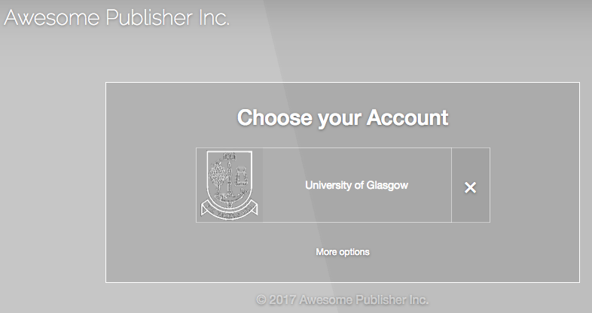
Main Use Case
“Awesome Publisher” retrieves from the WAYF Cloud information for Lisa’s Institutional Membership based on Lisa’s past history at other publishers sites
Lisa can login to her university with a single click
Assuming there is an ongoing session with that institution Lisa doesn’t even face another login screen

Slide 45
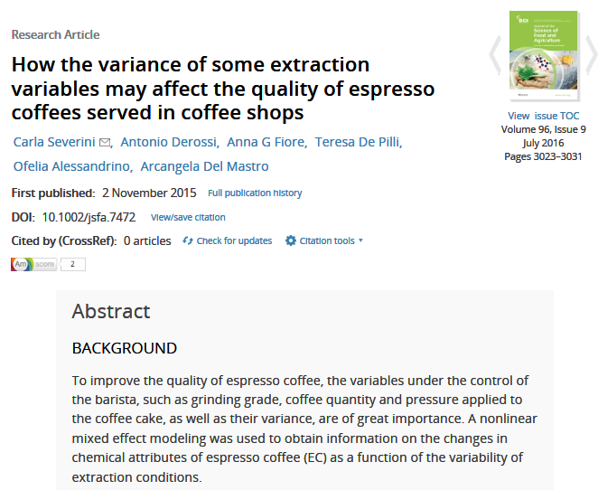
Detailed Use Case
Lisa, a college student is currently off campus, at her local coffee shop, looking for articles for her research paper. She finds a paper of interest from Publisher A, a participant in the WAYF-Cloud program
Publisher A
Since she is not in IP range nor currently logged into her college network, Lisa receives the dreaded “Access denied” message.

Slide 46
Detailed Use Case
Publisher A creates a unique ID (PUB ID) to identify this device.
WAYF Cloud
Publisher A
LISA’S
COMPUTER
Publisher A ID

Slide 47
Detailed Use Case
ID is sent by the publisher platform to the WAYF cloud using the WAYF API.
WAYF Cloud
Publisher A
LISA’S
COMPUTER
WAYF API
Publisher A ID
Publisher A ID

Slide 48
Detailed Use Case
ID is also sent to Lisa’s computer in a cookie and along with the WAYF Widget which allows Lisa’s computer to communicate with the WAYF Cloud
WAYF Cloud
Publisher A
LISA’S
COMPUTER
Publisher A ID
Publisher A ID
Publisher A ID
WAYF Widget
WAYF Widget

Slide 49
Detailed Use Case
The WAYF Widget makes a request to the WAYF Cloud, and sends Publisher A ID to it
This is the first time the WAYF Cloud see’s Lisa’s computer, so it generates a WAYF ID for it
WAYF Cloud
Publisher A
LISA’S
COMPUTER
Publisher A ID
WAYF ID
Publisher A ID
Publisher A ID
WAYF Widget

Slide 50
Detailed Use Case
The WAYF ID is saved also in Lisa’s Computer
WAYF Cloud
Publisher A
LISA’S
COMPUTER
Publisher A ID
WAYF ID
WAYF ID
Publisher A ID
Publisher A ID

Slide 51
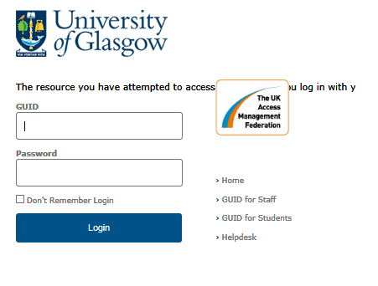
Detailed Use Case
Lisa uses Publisher A’s options to select her institution and login through her institutional website to gain access to the article
Publisher A

Slide 52
Detailed Use Case
Publisher A uses the WAYF Cloud API, to share that Lisa (Publisher A ID) logged in successfully form University of Glasgow
WAYF Cloud associates the WAYF ID with Lisa's University
WAYF Cloud
Publisher A
LISA’S
COMPUTER
WAYF API
Publisher A ID
Glasgow
WAYF ID
WAYF ID
Publisher A ID

Slide 53
Detailed Use Case
Lisa, finds another paper of interest from Publisher B, also a participant in the WAYF-Cloud program
Publisher B creates a unique ID (PUB ID) to identify this device.
Publisher B
LISA’S
COMPUTER
Publisher A ID
Glasgow
WAYF ID
WAYF ID
Publisher B ID

Slide 54
Detailed Use Case
Publisher’s B ID is sent to the WAYF cloud using the WAYF API.
WAYF Cloud
Publisher B
Publisher B ID
LISA’S
COMPUTER
WAYF API
Publisher A ID
Glasgow
WAYF ID
WAYF ID

Slide 55
Detailed Use Case
Publisher’s B ID also sent to Lisa’s computer in a cookie and along with the WAYF Widget
WAYF Cloud
Publisher B
Publisher B ID
LISA’S
COMPUTER
Publisher A ID
Glasgow
WAYF ID
WAYF ID
Publisher B ID
Publisher B ID
WAYF Widget
WAYF Widget

Slide 56
Detailed Use Case
The Widget transfer’s Publisher’s B ID to the WAYF Cloud
The WAYF Cloud now recognize’s Lisa by her WAYF ID, and can link Publisher’s B ID, to other Lisa’s Data (including association with University of Glasgow)
WAYF Cloud
Publisher B
LISA’S
COMPUTER
Publisher A ID
Glasgow
WAYF ID
Publisher B ID
WAYF ID
Publisher B ID

Slide 57
Detailed Use Case
Publisher B, can now ask the WAYF Cloud about Lisa, using the Publisher B ID
WAYF Cloud
Publisher B
LISA’S
COMPUTER
WAYF API
Publisher A ID
Glasgow
WAYF ID
Publisher B ID
WAYF ID
Publisher B ID

Slide 58
Detailed Use Case
Publisher B now has the information that Lisa is from University of Glasgow, without having to ask her
WAYF Cloud
Publisher B
LISA’S
COMPUTER
Publisher A ID
Glasgow
WAYF ID
Publisher B ID
WAYF ID
Glasgow

Slide 59
Detailed Use Case
Lisa can login to publisher B with a single click
Assuming there is an ongoing session with that institution Lisa doesn’t even face another login screen

Slide 60
WAYF Cloud - Highlights
Not a SAML Discovery Service
SAML/Shibboleth is supported as well as other standard protocols (e.g. open ID) and custom SSO
No redirection to a common 3rd party domain, no neutral UI
Native Look & Feel (not just publisher branding)
No hard dependency to any specific UI design
WAYF Cloud provides raw data to publisher platforms
Publishers platforms have full control over the UI
Final suggestions presented to the user are always valid for the given publisher
Allows mixing ‘local’ publisher specific login options in a single user interface

Slide 61
WAYF Cloud – User Interface Example
Publisher site header
…with IP Authentication
…with the WAYF Cloud

Slide 62
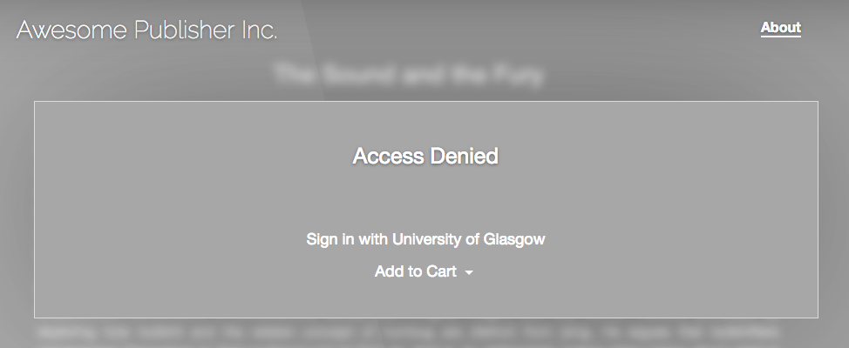
WAYF Cloud – User Interface Example
Access Denial Page

Slide 63
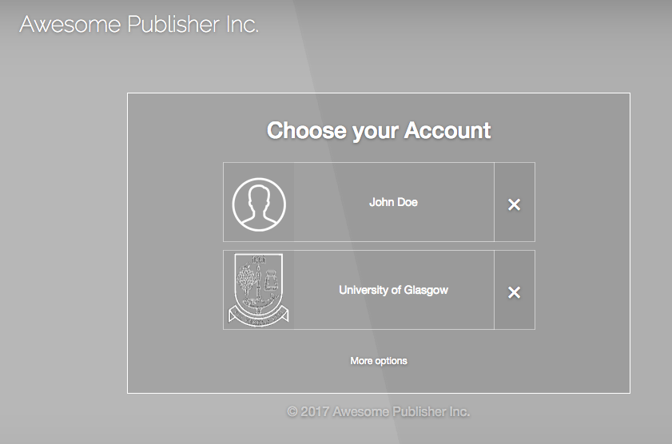
WAYF Cloud – User Interface Example
WAYF Cloud Data (user’s history)
University of Edinburgh
Doesn’t provide Access
New York University
Not supported by this publisher
University of Glasgow
Provides access and is supported
Sign in Page
Publisher Data
John Doe

Slide 64
Preserving Privacy & GDPR Compliance
GDPR Requirements | WAYF Cloud design
Users Consent | Users can easily give or withdraw their consent
Right to Access | Users can view their data with a user friendly UI
Right to Erasure | Users can remove their data with a user friendly UI
Psudoanonymization | User IDs are HASHED before they are stored in the WAYF Cloud
Data Breach Risk | Data stored in the WAYF Cloud cannot be used to: impersonate a user identify a real person (even when stolen data are combined with data from other sources)
FAQ:
https://wayf-cloud.readme.io/docs/privacy-faq

Slide 65
Preserving Privacy & GDPR Compliance
User
Institution
IdP Metadata
c7eac7ab-1ca5-4912-b1e7-edb501198fb0
Pseudoanonymized data
Public data
(available in the internet)

Slide 66
Pilot Participation
Roles & Responsibilities
Support design and development of the WAYF Cloud (All participants)
WAYF Cloud implementation, Platform Integrations, UI Design implementation (Lead by: Vendors, Publishers)
Determine usability evaluation process/methodology (Lead by: Libraries / Institutions)
Execute user testing and report results (Lead by: Libraries / Institutions)
Governance & Security (All participants)

Slide 67
Pilot Participation
Deliverables
Working demoable system, with publisher platforms integrated with the WAYF Cloud
A public Github repository with the source of the WAYF Cloud with an Open Source License
A report with the results from user testing
A set of recommendations for the governance and other operational aspects of the WAYF Cloud

Slide 68
Want to get involved?
Visit: https://www.RA21.org
Mailing lists:
P3W community list: https://lists.refeds.org/sympa/subscribe/p3w-community
WAYF Cloud community list: TBD
Everyone: Register your interest in participation by emailing: Julia@RA21.org and Heather@RA21.org

